Slide 1

MATHS WARM UP
YEAR 2 - TERM 2

Slide 2
fourteen
14
● | ● | ● | ● | ● | ● | ● | ● | ● | ●
● | ● | ● | ●

Slide 3
two
2
● | ●

Slide 4
five
5
● | ● | ● | ● | ●

Slide 5
twenty
20
● | ● | ● | ● | ● | ● | ● | ● | ● | ●
● | ● | ● | ● | ● | ● | ● | ● | ● | ●

Slide 6
nine
9
● | ● | ● | ● | ● | ● | ● | ● | ●

Slide 7
eleven
11
● | ● | ● | ● | ● | ● | ● | ● | ● | ●
●

Slide 8
thirteen
13
● | ● | ● | ● | ● | ● | ● | ● | ● | ●
● | ● | ●

Slide 9
fifteen
15
● | ● | ● | ● | ● | ● | ● | ● | ● | ●
● | ● | ● | ● | ●

Slide 10
ten
10
● | ● | ● | ● | ● | ● | ● | ● | ● | ●

Slide 11
sixteen
16
● | ● | ● | ● | ● | ● | ● | ● | ● | ●
● | ● | ● | ● | ● | ●

Slide 12
one
1
●

Slide 13
six
6
● | ● | ● | ● | ● | ●

Slide 14
three
3
● | ● | ●

Slide 15
twelve
12
● | ● | ● | ● | ● | ● | ● | ● | ● | ●
● | ●

Slide 16
seventeen
17
● | ● | ● | ● | ● | ● | ● | ● | ● | ●
● | ● | ● | ● | ● | ● | ●

Slide 17
nineteen
19
● | ● | ● | ● | ● | ● | ● | ● | ● | ●
● | ● | ● | ● | ● | ● | ● | ● | ●

Slide 18
eighteen
18
● | ● | ● | ● | ● | ● | ● | ● | ● | ●
● | ● | ● | ● | ● | ● | ● | ●

Slide 19
seven
7
● | ● | ● | ● | ● | ● | ●

Slide 20
four
4
● | ● | ● | ●

Slide 21
eight
8
● | ● | ● | ● | ● | ● | ● | ●

Slide 22
How Many?

Slide 31
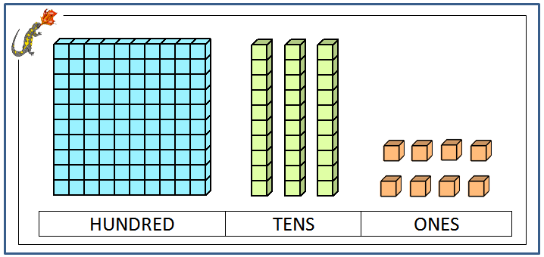
Make these numbers

Slide 32
58
10 less
67
1 more
69
68
78
1 less
10 more

Slide 33
153
10 less
162
1 more
164
163
173
1 less
10 more

Slide 34
DOUBLES
DOUBLE DOUBLE THIS THIS, DOUBLE DOUBLE THAT THAT

Slide 35
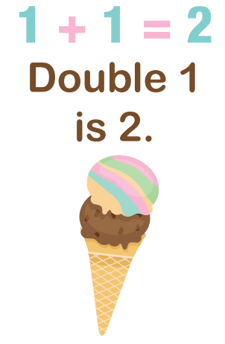

Slide 36
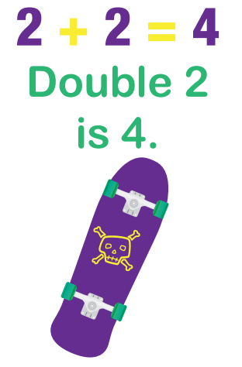

Slide 37
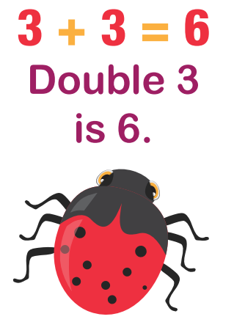

Slide 38
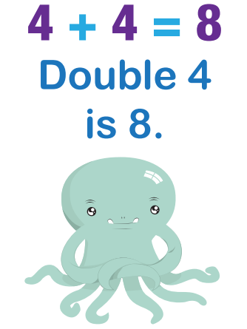

Slide 39
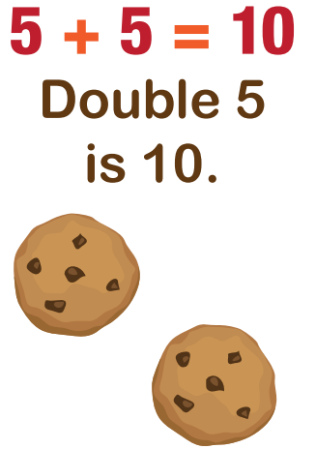

Slide 40
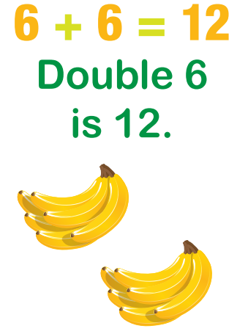

Slide 41
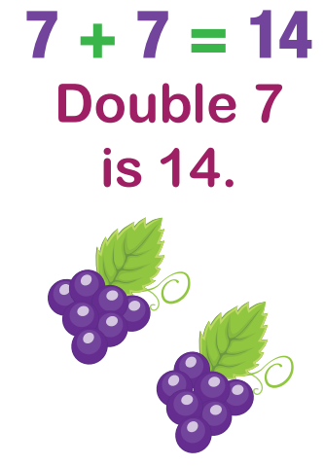

Slide 42
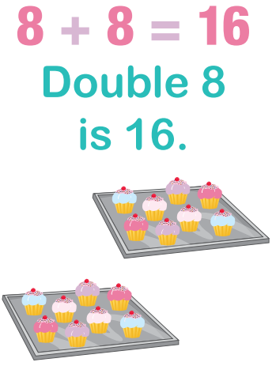

Slide 43
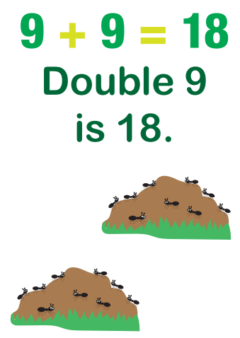

Slide 44
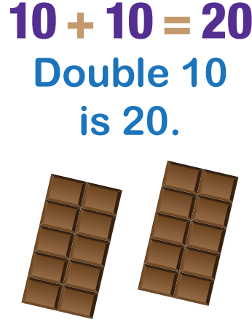

Slide 45
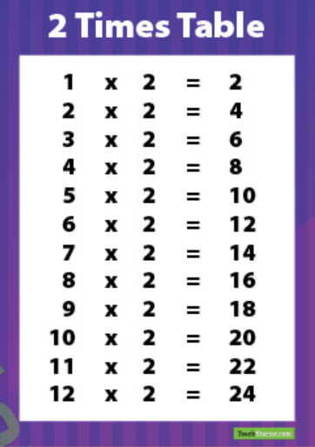

Slide 46
DAILY 10
https://www.topmarks.co.uk/maths-games/daily10

Slide 47
How many is half?

Slide 48

half of a group of 6 is 3

Slide 49

half of a group of 10 is 5

Slide 50

half of a group of 14 is 7

Slide 51
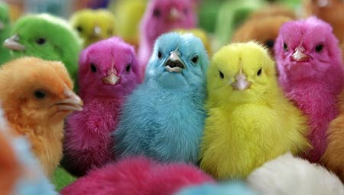
RAINBOW NUMBERS

Slide 52
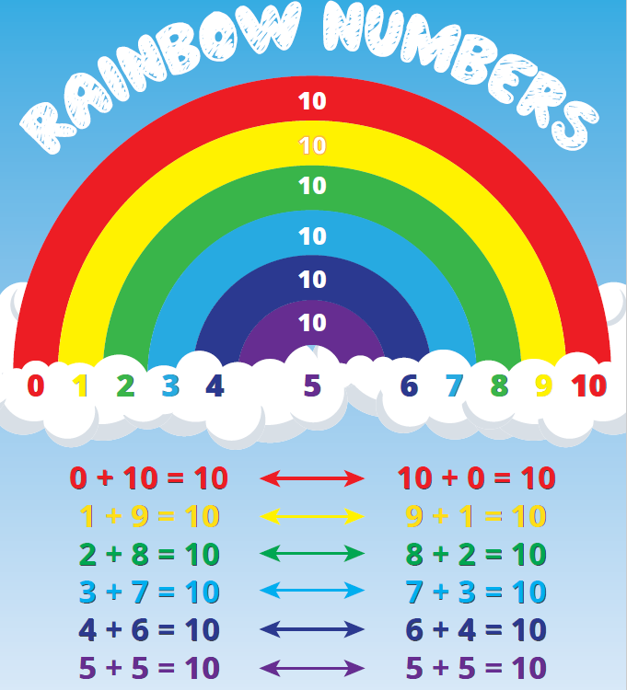

Slide 53
What’s missing?

Slide 54
1
9 + _ = 10

Slide 55
7
3 + _ = 10

Slide 56
10
0 + _ = 10

Slide 57
6
4 + _ = 10

Slide 58
2
8 + _ = 10

Slide 59
2
18 + _ = 20

Slide 60
8
12 + _ = 20

Slide 61
25 + _ = 30
5

Slide 62
__ + 40c = $1

Slide 63
__ + 70c = $1

Slide 64
__ + 90c = $1

Slide 65
__ + 5 = 60

Slide 66
__ + 2 = 90

Slide 67
__ + 9 = 80

Slide 68
TIME

Slide 70
Thirty days has September,
April, June and November.
Thirty-one days have the rest except for this real special guest..
February is its name and twenty-eight days is its claim.
But in a leap year you will find its days add up to twenty-nine!!

Slide 72
What time is it?

Slide 73
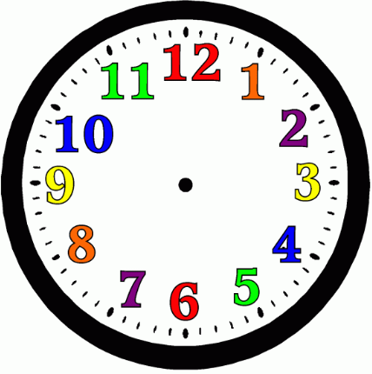
7:00
seven o’clock

Slide 74
11:30
half past eleven

Slide 75
6:00
six o’clock

Slide 76
1:30
half past one

Slide 77
12:00
twelve o’clock
midnight
midday

Slide 78
quarter to

Slide 79
digital clock

Slide 80
hour

Slide 81
analogue clock

Slide 82
half

Slide 83
midday

Slide 84
o’clock

Slide 85
half hour

Slide 86
quarter past

Slide 87
minute

Slide 88
midnight

Slide 89
half past

Slide 90
noon

Slide 91
TIME BINGO
Analogue
Digital
Hour
Minute
O’clock
Half past
Quarter past
Quarter to
Noon
Midday
Midnight

Slide 92
What is another way of saying 30 minutes?
Meg got home from school at 3pm. Her mum said she could have a snack after she had cleaned her room for half an hour and done 15 minutes of homework. What time was Meg allowed to have her snack? Write the digital time.
Meg got home from school at 3pm. Her mum said she could have a snack in half an hour. What time was Meg allowed to have her snack? Write the digital time.

Slide 93
Money

Slide 94
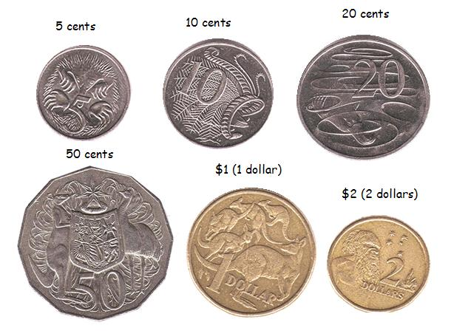
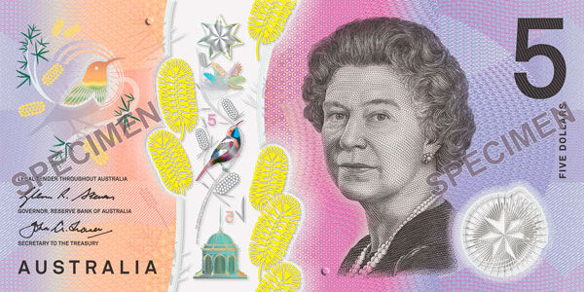
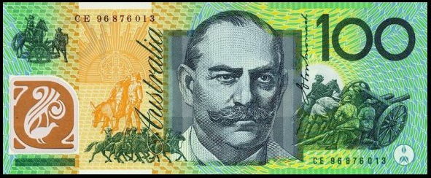
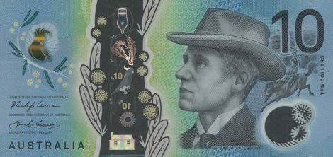

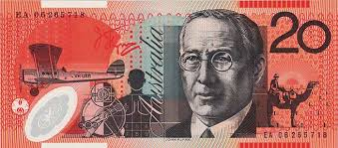

Slide 95
How much?

Slide 96
$6
six dollars

Slide 97
$0.65
sixty-five cents

Slide 98
$2
two dollars

Slide 99
$8.50
eight dollars and fifty cents

Slide 100
$75
seventy-five dollars

Slide 101
$143
one hundred and forty-three dollars

Slide 102
$121.70
one hundred and twenty-one dollars and seventy cents

Slide 103
Ben bought 2 lollies that cost $2 each. How much money did he spend?
Ben bought 6 lollies that cost $2 each. How much money did he spend?
Ben had $16 to spend at the store. He bought 6 lollies that cost $2 each. How much money did he have left over?

Slide 104


