Slide 1
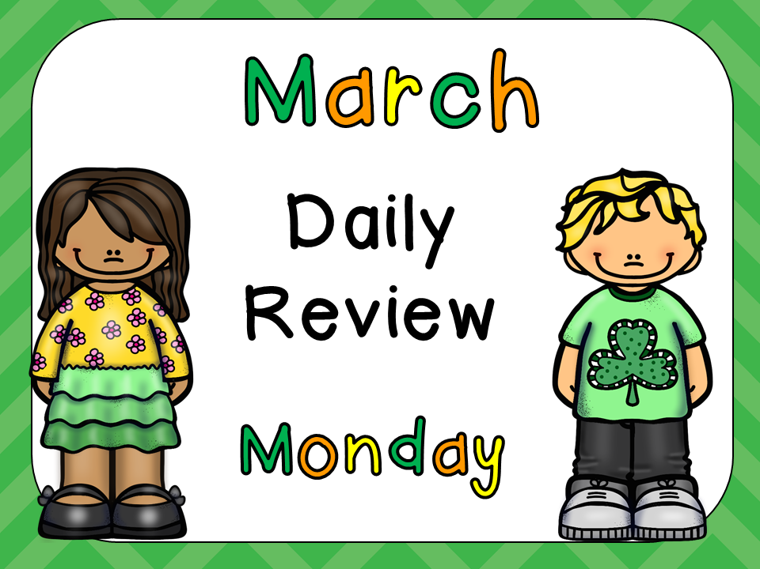

Maths

Slide 2
Count to 10 –
forwards and backward
Read the words
one
two
three
four
five
six
seven
eight
nine
ten

Slide 3
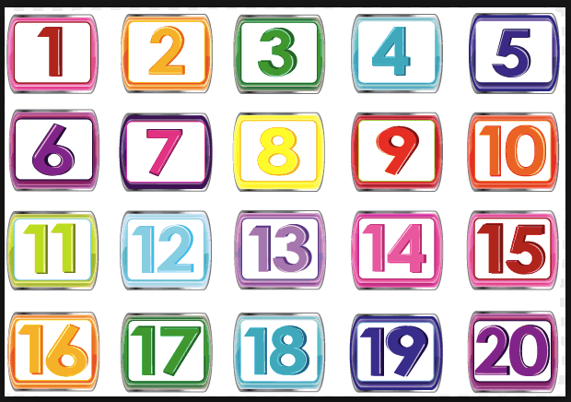
Count to 20.
Count backwards
from 20 to 0.

Slide 4
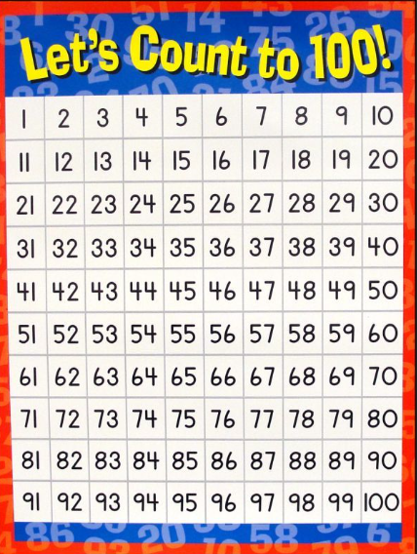
Counting – Practice starting from different numbers.

Slide 5
Point to the numbers
in random order –
Have your child say
the number name.
How fast can you go?

Slide 6
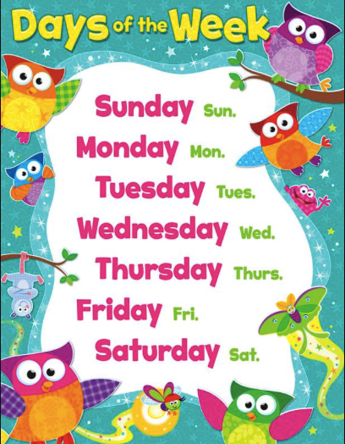

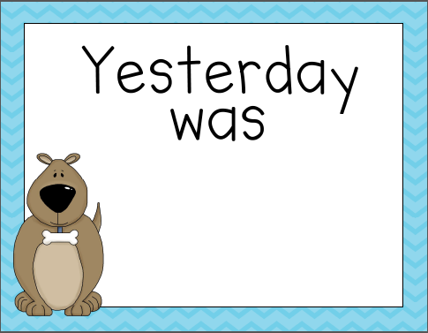

Say the days
of the week.

Slide 7
shapes

Slide 15
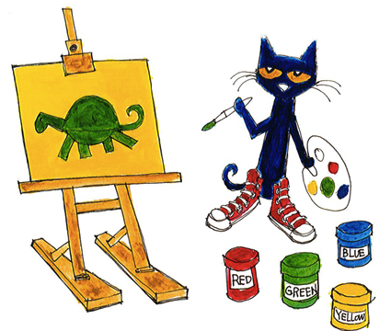
Colours

Slide 16
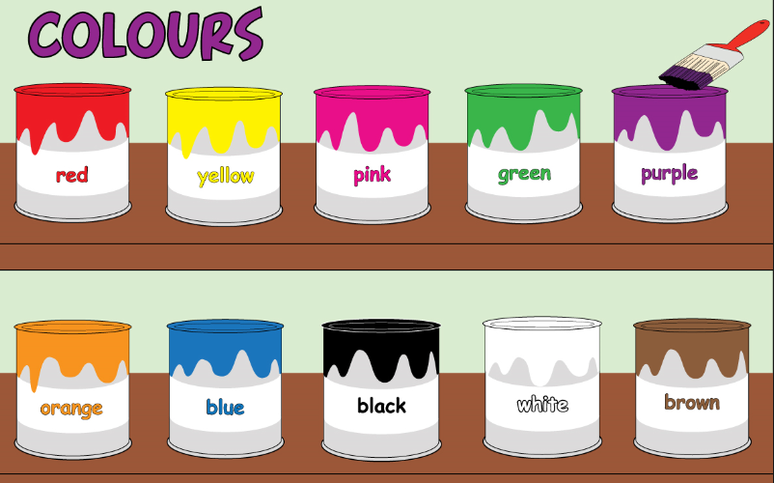

Slide 17
The End

