Slide 1

Reading Warm Ups
Year 2
Term 2, 2020

Slide 2

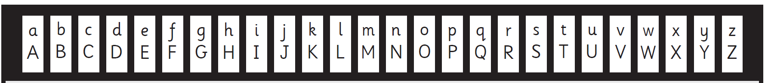

There are 26 graphemes in the alphabet
A is the first grapheme.
Z is the last grapheme.
M is the middle grapheme.
A phoneme is the sound that the grapheme makes.
a, e, i, o and u are vowels
All other graphemes are consonants

Slide 3
2. Blending and Tracking

Slide 4
A blend is two or three letters that join together.

Slide 5
An initial blend is at the start of a word.

Slide 6

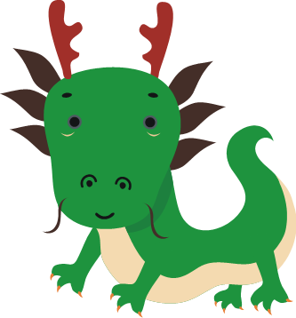


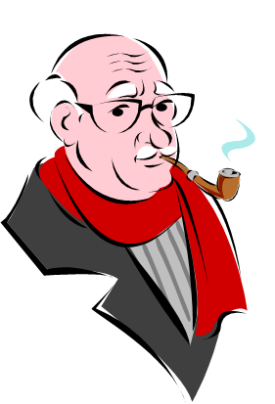


br
dr
fr
bride
frog
cr
gr
tr
dragon
crab
grandad
tree
present

Slide 7
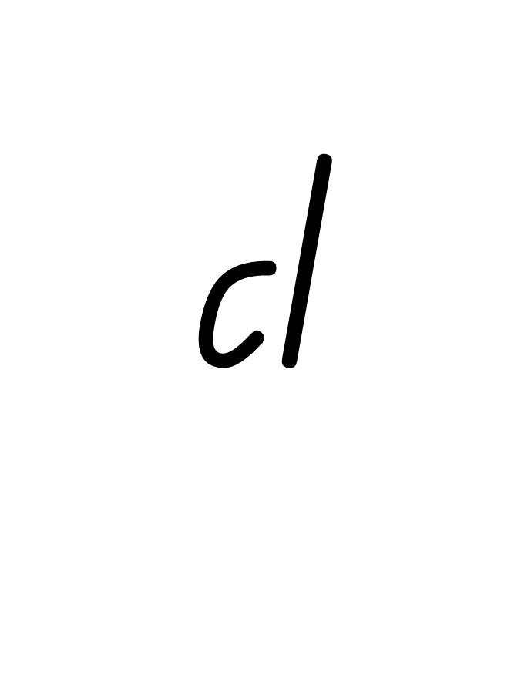

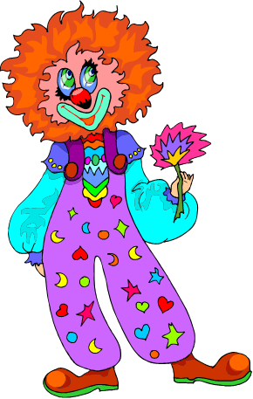











bl
blocks
clown

Slide 8


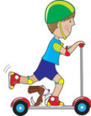

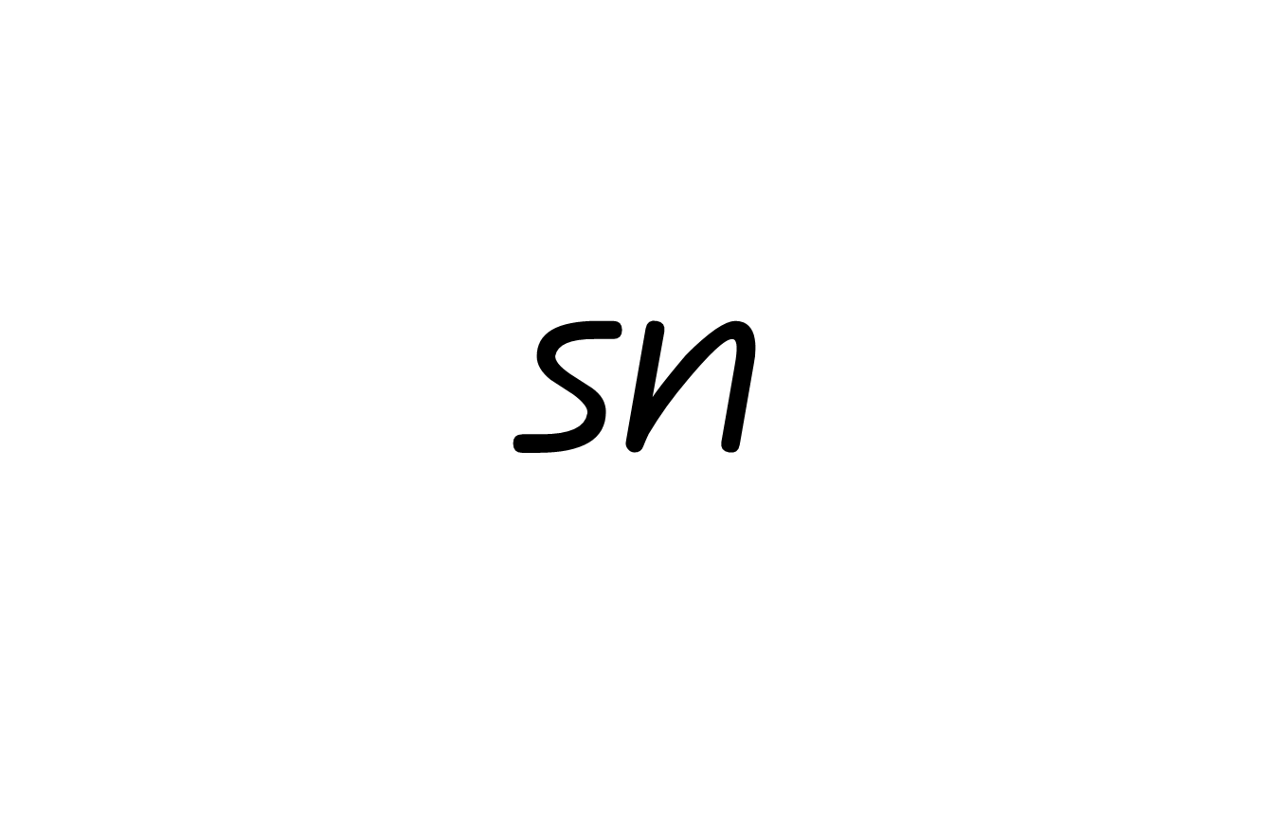

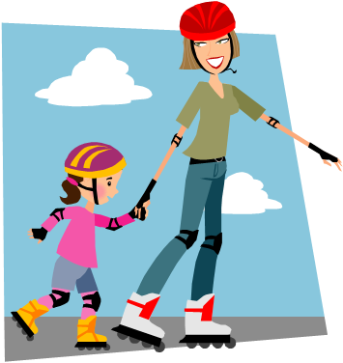


sc
scooter
smile
skate
snake
spider

Slide 9
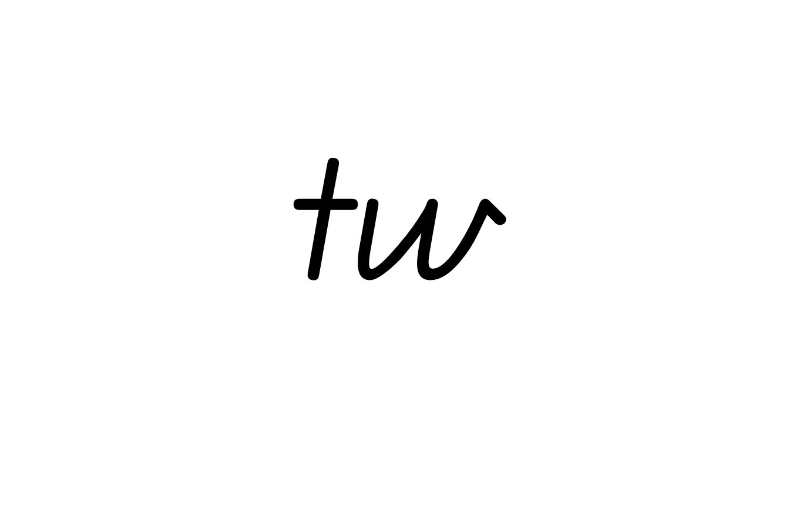


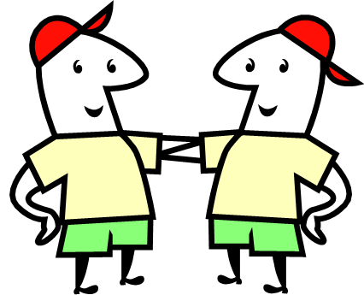
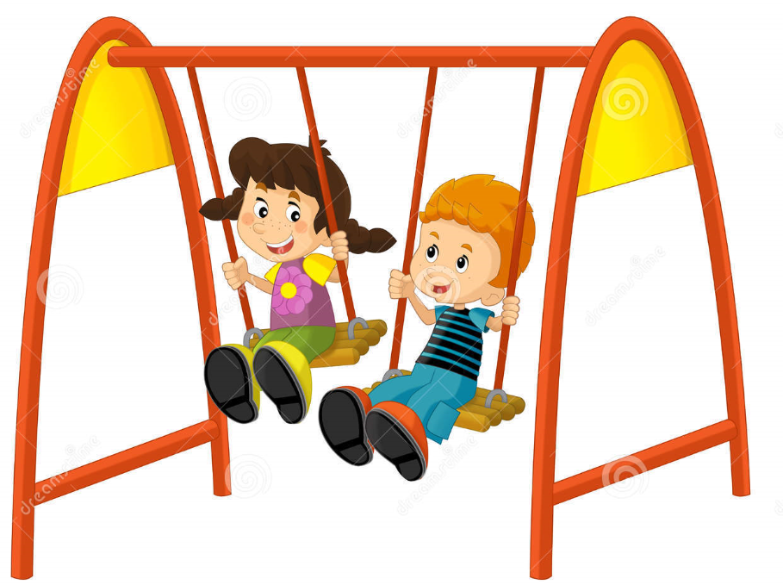
st
stop
twins
swing

Slide 10
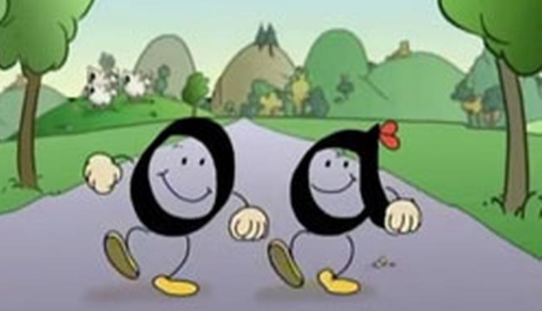
Digraphs
Two letters making one sound
When 2 vowels go walking,
the first one does the talking!

Slide 11

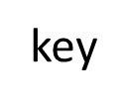




ay
ey
pay

Slide 12
An final blend is at the end of a word.

Slide 13

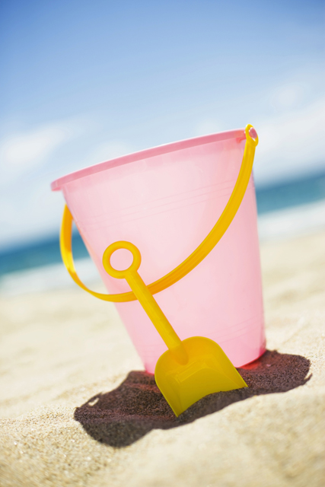



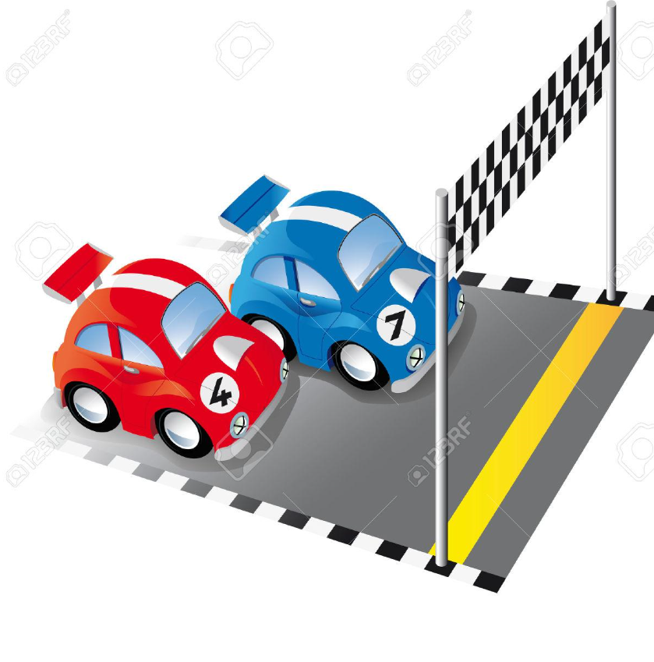

nd
sand
tank
first
wasp

Slide 14







belt
jump
mp
palm
bulb

Slide 15

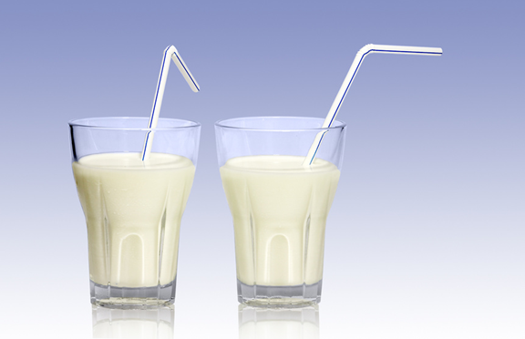


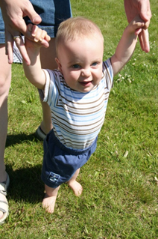

lf
wolf
milk
cold
help

Slide 16
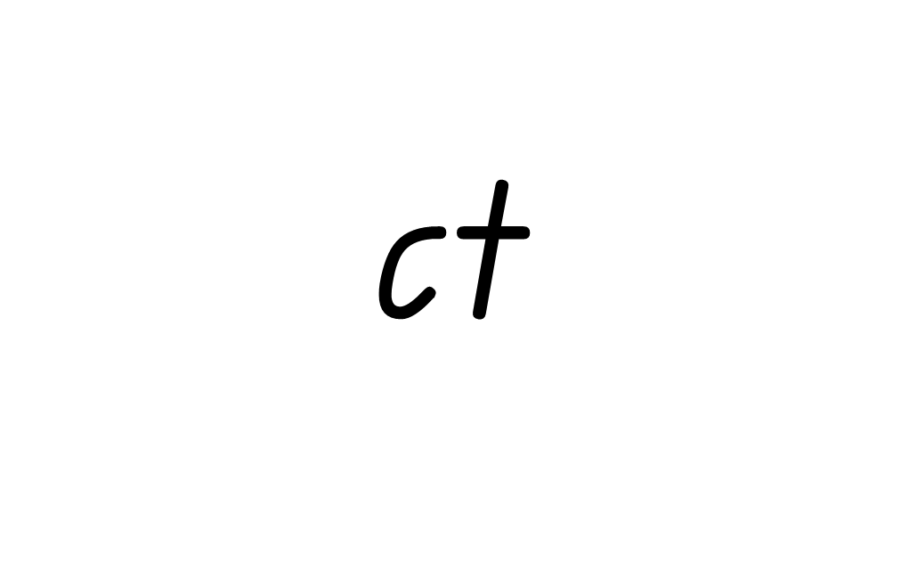
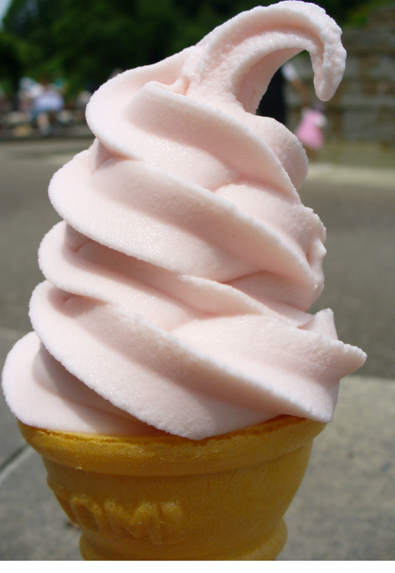
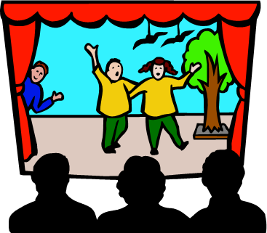
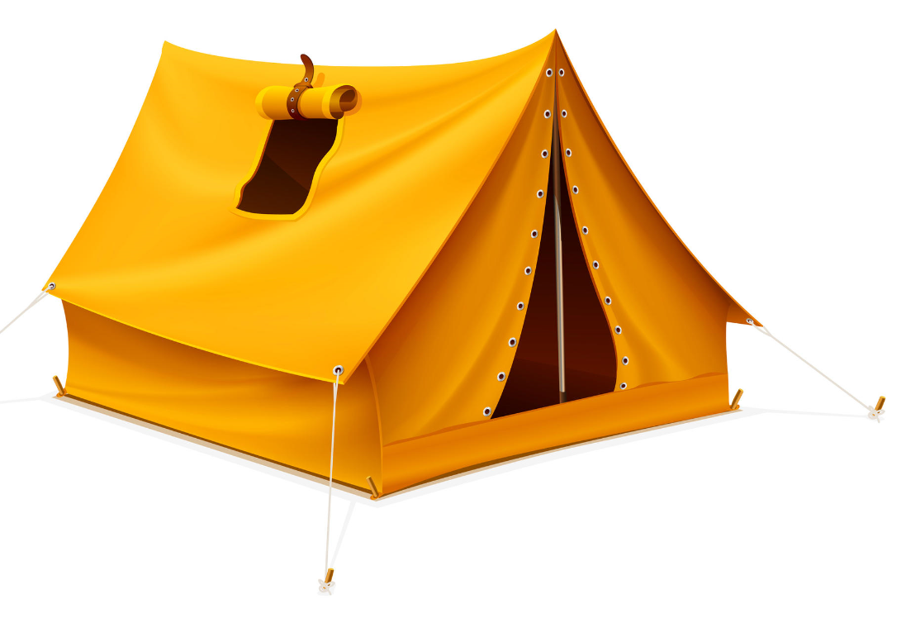
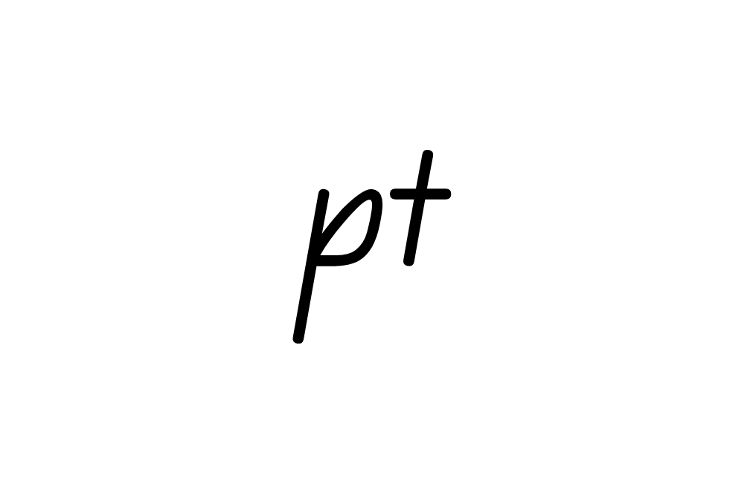
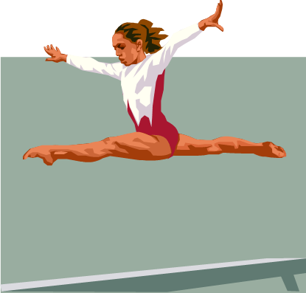

ft
soft
act
leapt
tent

Slide 17
Digraphs
Two letters making one sound

Slide 18
al
ball

Slide 19
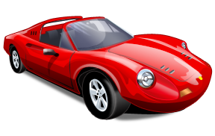
ar
car

Slide 20
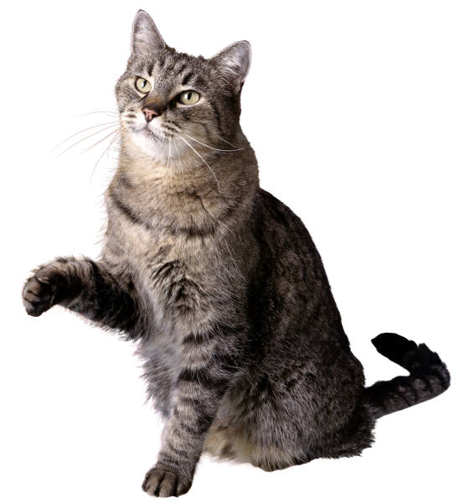
aw
paw

Slide 21
ay
pay

Slide 22
er
tiger

Slide 23
ew
screw

Slide 24
ey
key

Slide 25
ir
girl

Slide 26
ow
cow

Slide 27
ow
grow

Slide 28
oy
boy

Slide 29
or
fork

Slide 30
ur
nurse

Slide 31
ch
chin

Slide 32
ck
duck

Slide 33
gn
gnome

Slide 34
kn
knee

Slide 35

ph
phone

Slide 36
qu
queen

Slide 37
sh
ship

Slide 38
th
thin
unvoiced

Slide 39
th
them, this, that, they
Voiced (buzzy feeling on tongue)

Slide 40
wh
whistle

Slide 41
le
rattle

Slide 42
Vowels with Diagraphs

Slide 43
ang
eng
ing
ong
ung

Slide 44


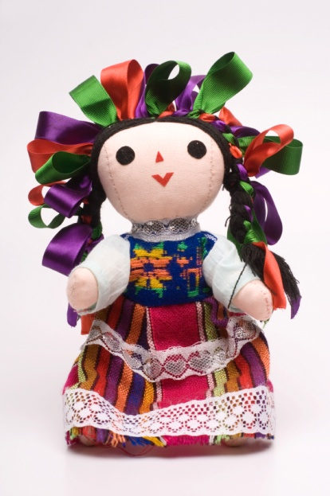
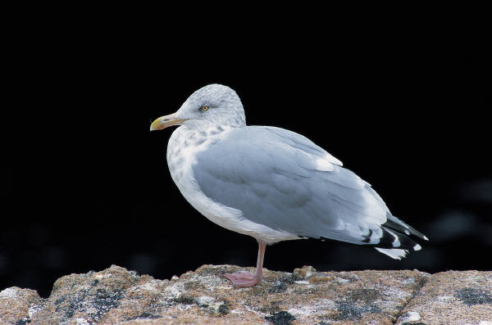
ell
ill
oll
ull

Slide 45
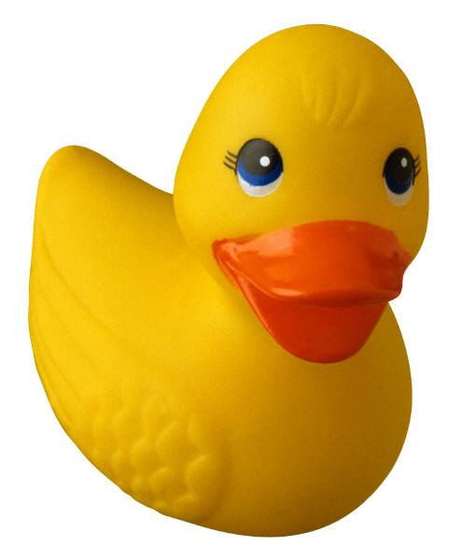
ack
eck
ick
ock
uck

Slide 46
Trigraph
These trigraphs have three letters representing one sound (phoneme).
igh eer ear air are dge tch

Slide 47

igh
night

Slide 48
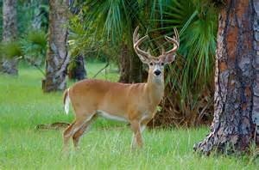
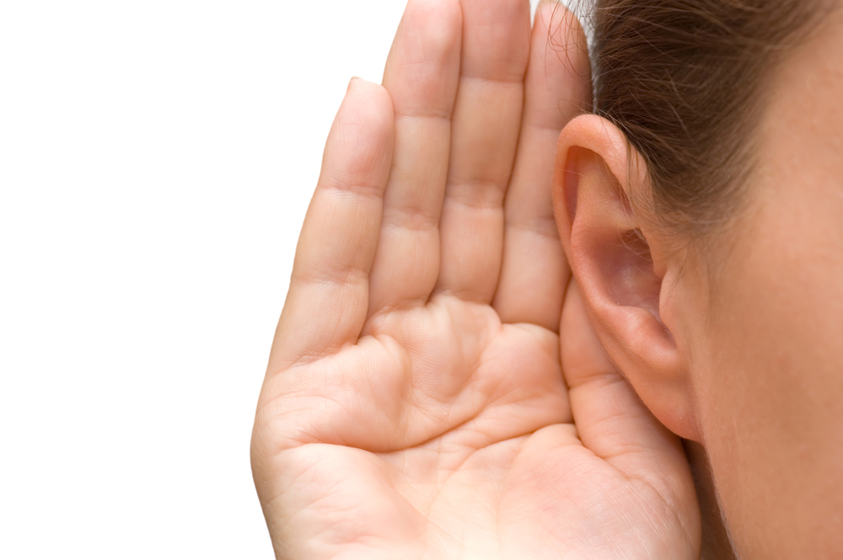
eer
ear
deer
hear

Slide 49
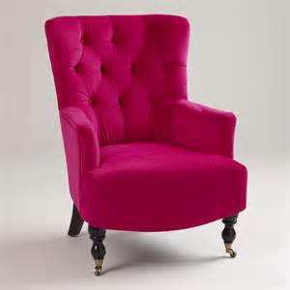
air
are
chair
square

Slide 50

dge
bridge

Slide 51
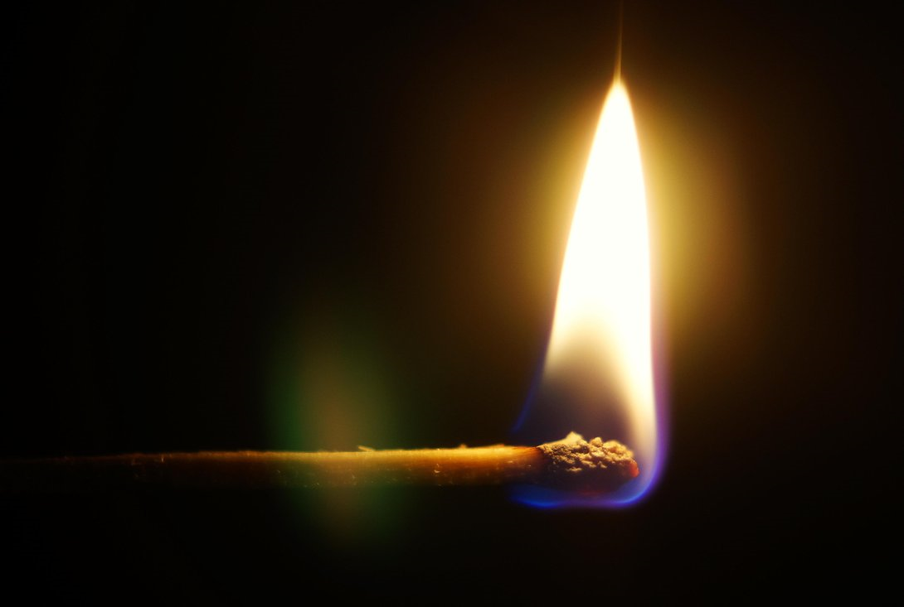
tch
match

Slide 52
BLENDING
Track with your eyes from 1st sound to last sound, blending as we go.
a
e
i
o
u
Eg: flan, flen, flin, flon, flun x3, This is how we blend.
Use magnetic letters on whiteboard.
dge
h

Slide 53
Nonsense Words
- Blending

Slide 54
Make a meaning for this word
computterlittering

Slide 55
3. Segmenting
The visual breaking down of unknown words into individual sounds or syllables (chunking of words)
Gas/tro/en/ter/ol/o/gist

Slide 56
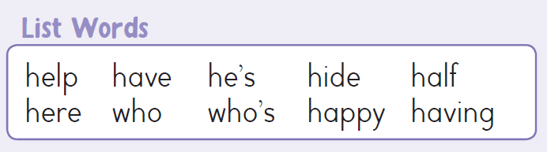
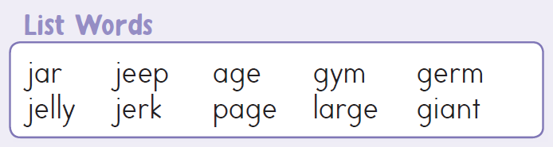

Slide 57
4. Syllables
The auditory breaking down of unknown words into individual sounds or syllables (chunking of words)
e.g. clapping out parts of the word
(star-fish)
This is not sounding out e.g (s/t/ar/f/i/sh)

Slide 59
Sight Words

Slide 60
about

Slide 61
first

Slide 62
could

Slide 63
make

Slide 64
little

Slide 65
look

Slide 66
right

Slide 67
other

Slide 68
their

Slide 69
want

Slide 70
where

Slide 71
which

Slide 72
there

Slide 73
after

Slide 74
am

Slide 75
boy

Slide 76
day

Slide 77
eat

Slide 78
five

Slide 79
fly

Slide 80
girl

Slide 81
good

Slide 82
help

Slide 83
home

Slide 84
jump

Slide 85
play

Slide 86
ran

Slide 87
read

Slide 88
saw

Slide 89
sing

Slide 90
sit

Slide 91
think

Slide 92
us

Slide 93
ask

Slide 94
best

Slide 95
bring

Slide 96
far

Slide 97
find

Slide 98
give

Slide 99
how

Slide 100
kind

Slide 101
left

Slide 102
man

Slide 103
mother

Slide 104
own

Slide 105
room

Slide 106
say

Slide 107
step

Slide 108
these

Slide 109
too

Slide 110
walk

Slide 111
wish

Slide 112
again

Slide 113
always

Slide 114
away

Slide 115
bird

Slide 116
dog

Slide 117
fast

Slide 118
four

Slide 119
going

Slide 120
hand

Slide 121
keep

Slide 122
let

Slide 123
many

Slide 124
night

Slide 125
people

Slide 126
round

Slide 127
school

Slide 128
take

Slide 129
thing

Slide 130
tree

Slide 131
water

Slide 132
work

Slide 133
another

Slide 134
bad

Slide 135
black

Slide 136
don’t

Slide 137
father

Slide 138
found

Slide 139
got

Slide 140
head

Slide 141
know

Slide 142
live

Slide 143
may

Slide 144
once

Slide 145
put

Slide 146
run

Slide 147
should

Slide 148
tell

Slide 149
three

Slide 150
under

Slide 151
white

Slide 152
would

Slide 153
any

Slide 154
because

Slide 155
blue

Slide 156
every

Slide 157
fell

Slide 158
gave

Slide 159
green

Slide 160
house

Slide 161
last

Slide 162
long

Slide 163
morning

Slide 164
open

Slide 165
red

Slide 166
sat

Slide 167
soon

Slide 168
than

Slide 169
time

Slide 170
very

Slide 171
why

Slide 172
year

Slide 173
Procedures

Slide 174
The purpose of the procedure..
is to instruct through a series of steps, how to make or do something.

Slide 175
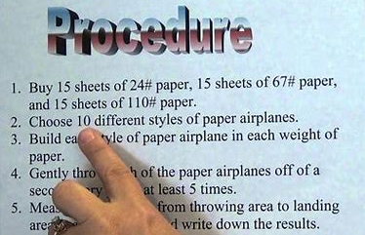
A procedure has …
Headings
List of tools or ingredients
Commands as steps
Include action verbs and prepositions

Slide 176
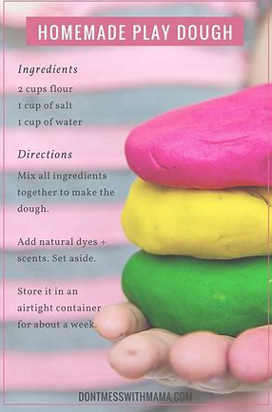
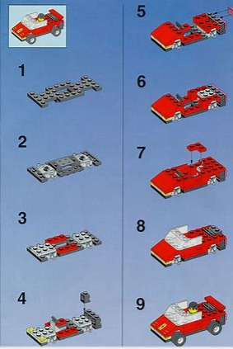
Examples of procedures are …
Recipes
Science experiment procedure
How to build Lego
How to build IKEA furniture

Slide 177
What is a COMMAND?
Pay attention!
Short sentences that tell us what to do.
Start with a capital letter and end with a full stop.
Start with an action verb.
Listed in numbered steps that show a sequence.
Often include groups of words that tell where.

Slide 178
Reading Comprehension

Slide 179
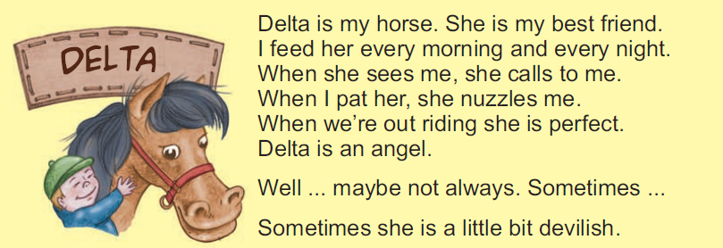

Slide 180
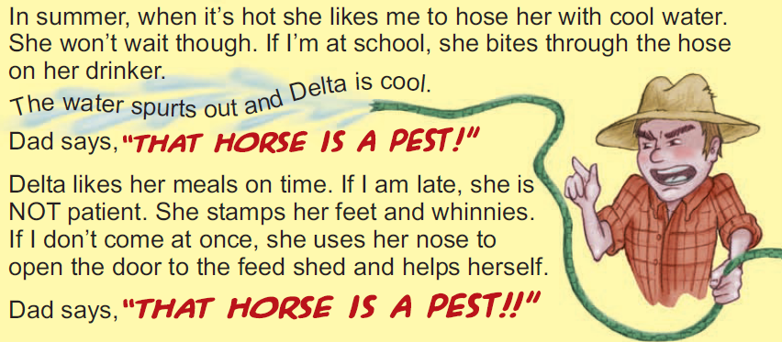

Slide 181
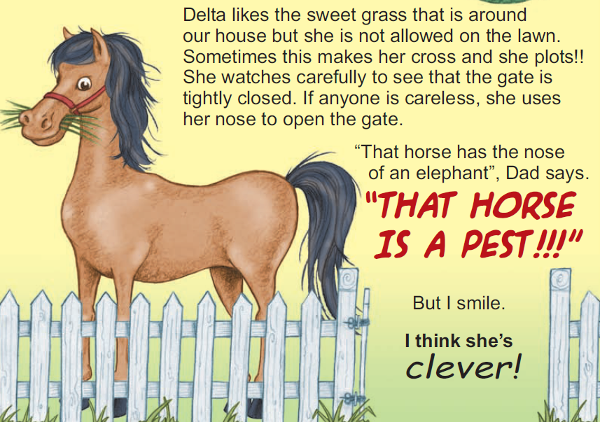

Slide 182
APPLY! Literal, inferential and critical questions.
Literal (right in front of your face)
Who is the author’s best friend?
What does Delta do when the author pats her?
Is Delta patient? How do we know?
Inferential (use the clues - we have to dig deeper)
Why does Delta go into the feed shed if the author is late to give her a meal?
Critical (on your own – tell me why/justify)
Do you agree with Dad’s opinion or the author’s opinion of Delta, why?

Slide 183
Reading Fluency

Slide 184
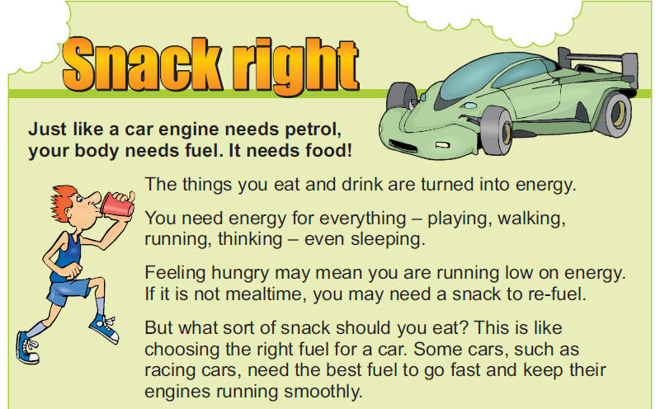

Slide 185


