Slide 1
Writing
Week 1

Slide 2
Simple Sentences
A simple sentence has a CAPITAL LETTER and a full stop.
It needs to make sense!
Today is Wednesday.
I am a teacher.
My favourite colours are turquoise and pink.

Slide 3
Wow Words
Words we can use to make our writing more exciting and interesting.
adorable
Definition
Inspiring great affection or delight. loveable, charming, cute, sweet
Example
I have two adorable Siamese kittens.
playful
Definition
Fond of games and having fun. frisky, jolly, fun-loving
Example
The playful kitten chased the ball of wool.

Slide 4
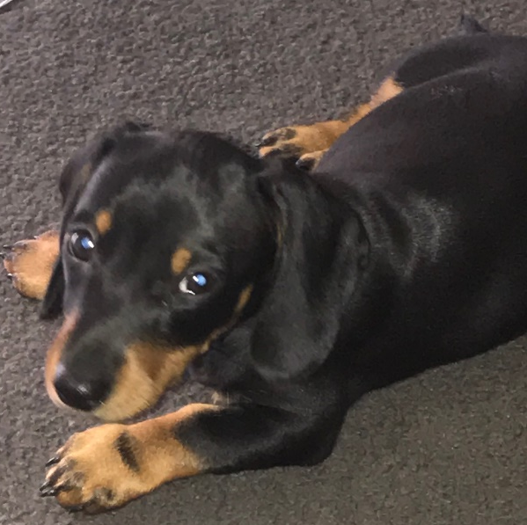
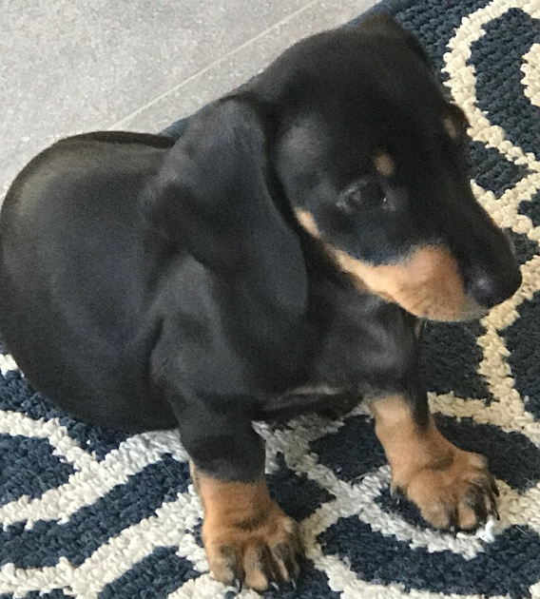
Simple Sentences
Parts of a simple sentence
When (when did it happen)
who or what is involved (nouns and noun groups)
what is happening (the verbs)
To help us remember, we say “when comma who what they did full stop”.
Let’s look at a sentence
Last night, the adorable puppy chewed my long shoelaces.

Slide 5
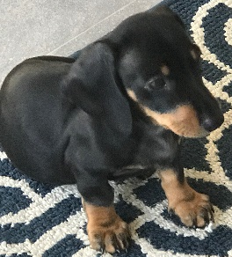

Now let’s break it down.
Last night, the adorable puppy chewed my long shoelaces.
When?
last night
Who was involved?
the adorable puppy
What happened?
chewed
Chewed what?
my long shoelaces
Last night, the adorable puppy chewed my long shoelaces.

Slide 6
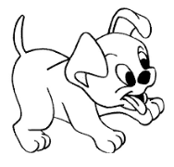
Now it’s your turn to write.
Copy this sentence into your writing book. Don’t forget to start with a capital letter and finish with a full stop. You can draw a picture if you like.
Last night, the adorable puppy chewed my long shoelaces.

Slide 7
Writing
Week 2

Slide 8
Simple Sentences
A simple sentence has a CAPITAL LETTER and a full stop.
It needs to make sense!
Today is Tuesday.
I am a teacher.
My favourite colours are turquoise and pink.

Slide 9
Wow Words
Words we can use to make our writing more exciting and interesting.
amusing
Definition
Causing laughter or delight.
funny, hilarious
Example
I read a very amusing book.
cheerful
Definition
Full of cheer or in good spirits.
happy, joyful, merry
Example
My sister is a cheerful person.

Slide 10
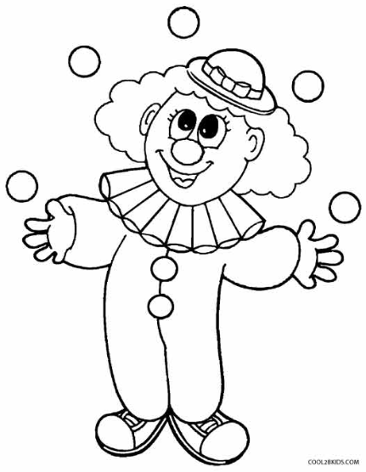
Simple Sentences
Parts of a simple sentence
When (when did it happen)
who or what is involved (nouns and noun groups)
what is happening (the verbs)
To help us remember, we say “when comma who what they did full stop”.
Let’s look at a sentence
On Sunday, the clever clown juggled five balls.

Slide 11
Now let’s break it down.
on Sunday
When?
Who was involved?
the clever clown
What happened?
juggled
Juggled what?
five balls
On Sunday, the clever clown juggled five balls.

Slide 12
Now it’s your turn to write.
Copy this sentence into your writing book. Don’t forget to start with a capital letter and finish with a full stop. You can draw a picture if you like.
On Sunday, the cheerful clown juggled five balls.

