Slide 1
WRITING WARM UPS

Slide 2
Parent/Carer Information:
Writing warm ups should only take about
10-15 minutes.
There is one slide per day in this powerpoint.
Expanding vocabulary is a useful tool in helping your child improve their writing. Encourage your child to explore new words and their meanings and how they can be used to help make writing more interesting.

Slide 3
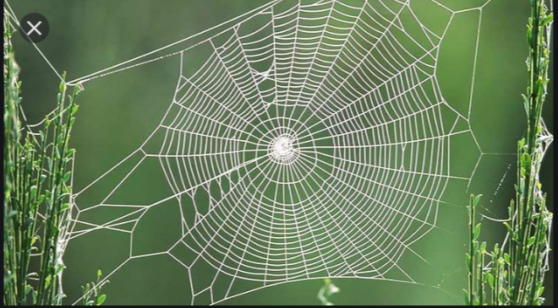
Week 1
Monday
What do you notice in this picture?
What do you wonder about this picture?
Brainstorm some words that could be used in describing the picture. Write them down and get an adult to help with spelling. (eg. Intricate, gossamer, delicate…) Discuss meanings of new words.
Write a really interesting sentence using one or more of your words.
Choose your favourite word to add to your word wall at home (to use in any other writing you do).

Slide 4
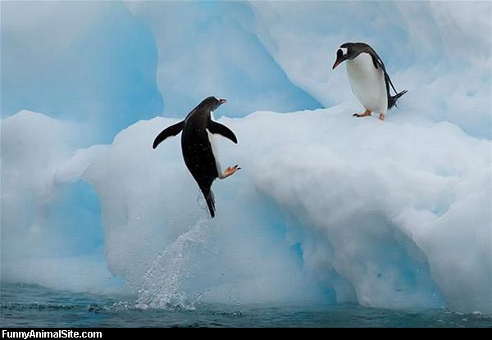
What do you notice in this picture?
What do you wonder about this picture?
Brainstorm some words that could be used in describing the picture. Write them down and get an adult to help with spelling. (eg: determined, agile, etc.) Discuss meanings of new words.
Write a really interesting sentence using one or more of your words.
Choose your favourite word to add to your word wall at home (to use in any other writing you do).
Week 1
Tuesday

Slide 5
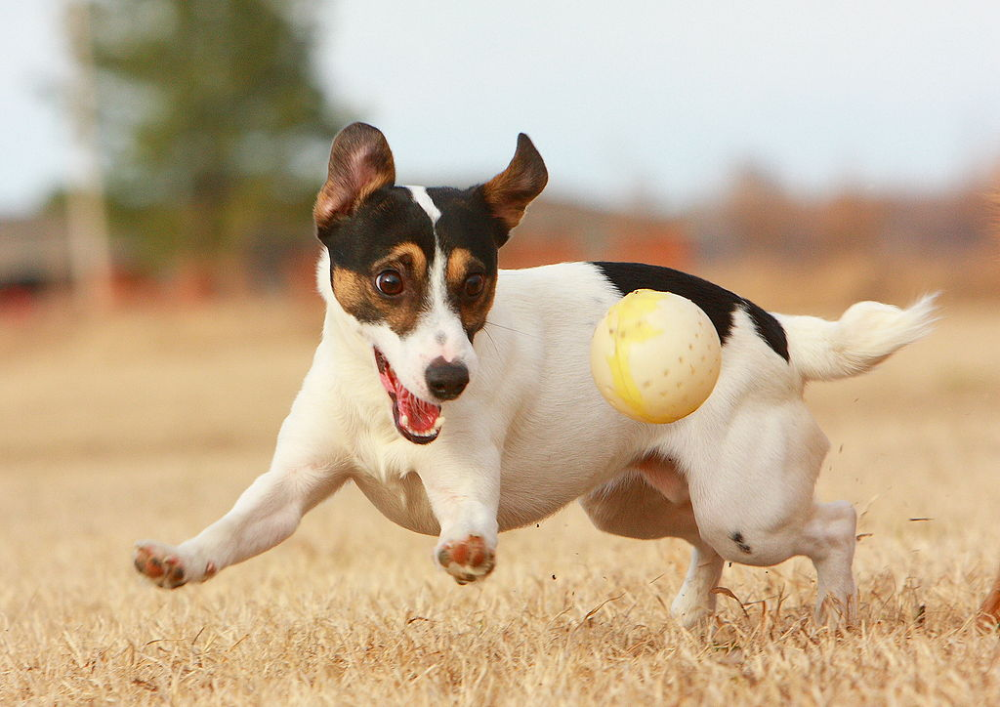
Week 1: Wednesday
What do you notice in this picture?
What do you wonder about this picture?
Brainstorm some words that could be used in describing the picture. Write them down and get an adult to help with spelling. (eg: playful, focused) Discuss meanings of new words.
Write a really interesting sentence using one or more of your words.
Choose your favourite word to add to your word wall at home (to use in any other writing you do).

Slide 6
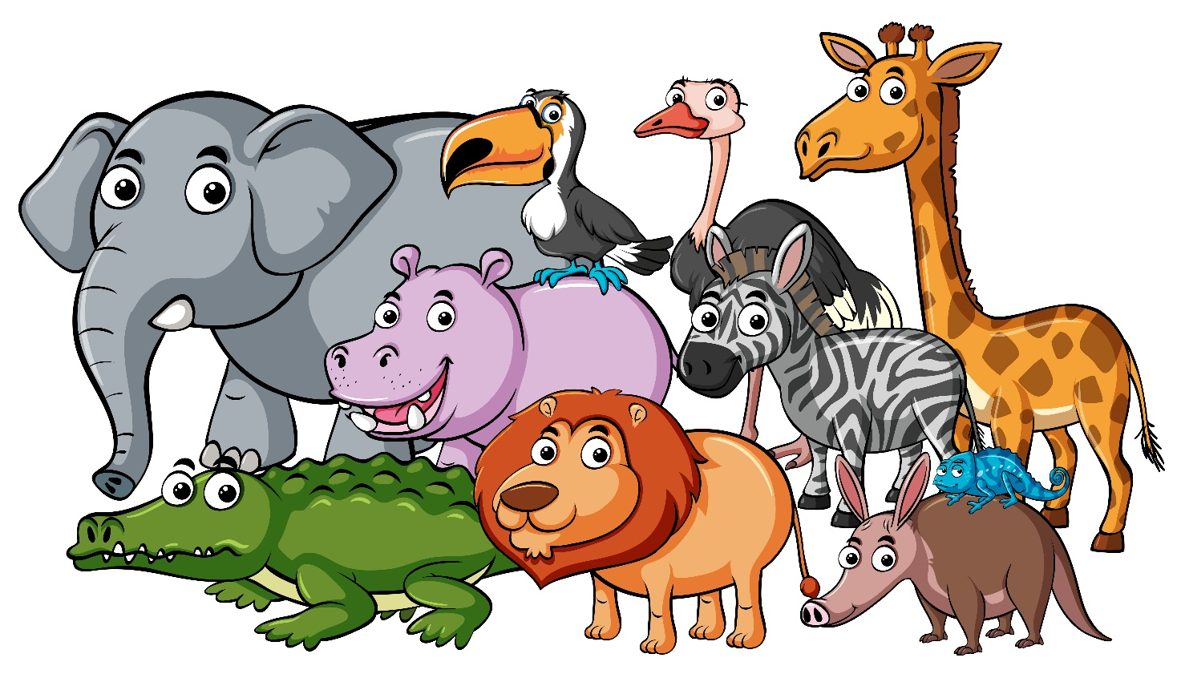
Week 1: Thursday
Write four sentences about your favourite animal. You could write about what they look like, what they eat, where they live, and more! Why is it your favourite animal? (You could try using some words on your word wall to make your sentences more interesting.)

Slide 7
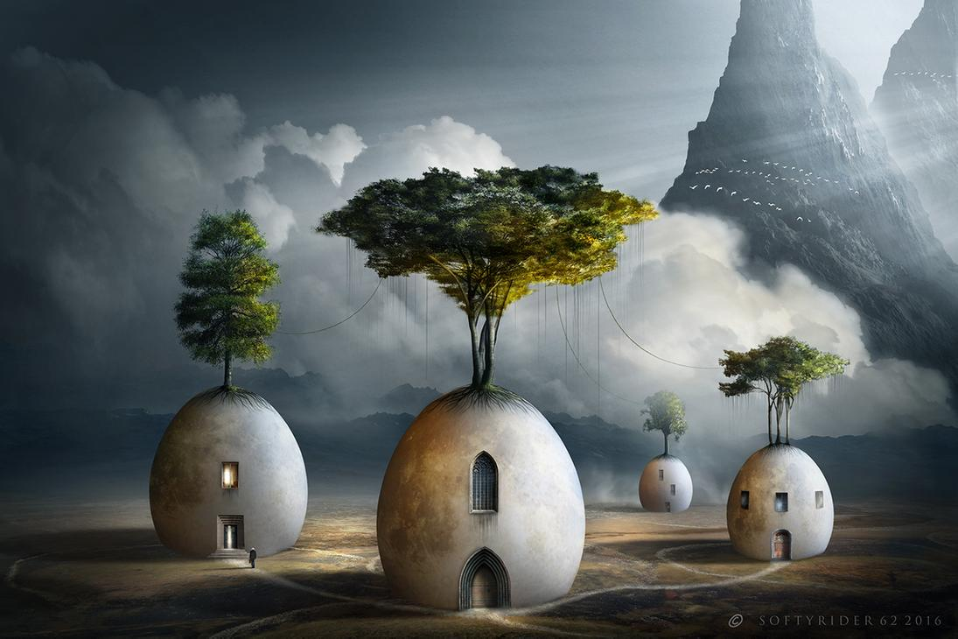
Week 1: Friday
What do you notice in this picture?
What do you wonder about this picture?
Brainstorm some words that could be used in describing the picture. Write them down and get an adult to help with spelling. (eg: eerie, mysterious, intriguing) Discuss meanings of new words.
Write a really interesting sentence using one or more of your words.
Choose your favourite word to add to your word wall at home (to use in any other writing you do).

Slide 8
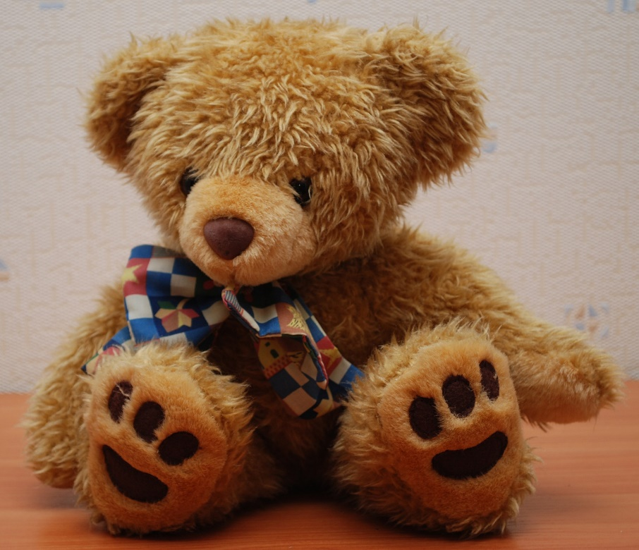

Week 2: Monday
List ten things that you have in your bedroom.
Write an adjective (a describing word) for each thing you listed.
Eg: bed……comfortable bed
teddy….furry teddy

Slide 9
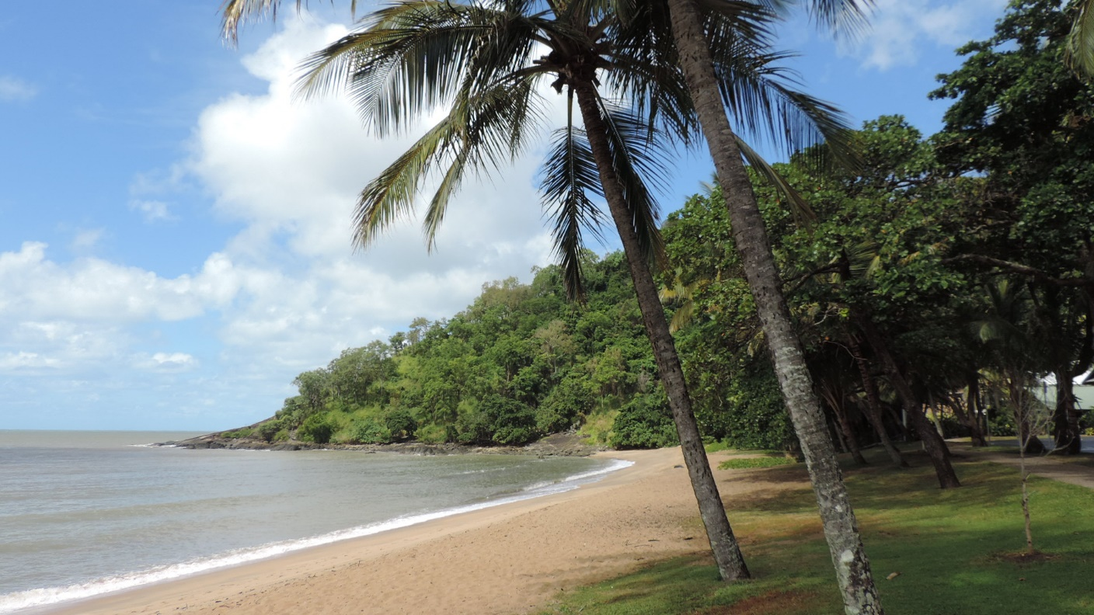
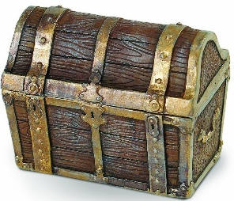
You find a treasure chest washed up on the shore of your favourite beach. Write down what you find inside. Write in sentences, making sure you use plenty of adjectives (describing words)!
Week 2: Tuesday

Slide 10
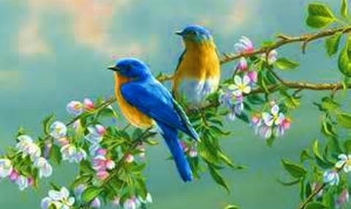
Week 2: Wednesday
Oops! There are six mistakes in this sentence. Can you rewrite the sentence correctly – remember capital letters, correct spelling and punctuation.
watching the beautiful berds in the tree, mary sat as quite as she could so they didnt get frightened

Slide 11
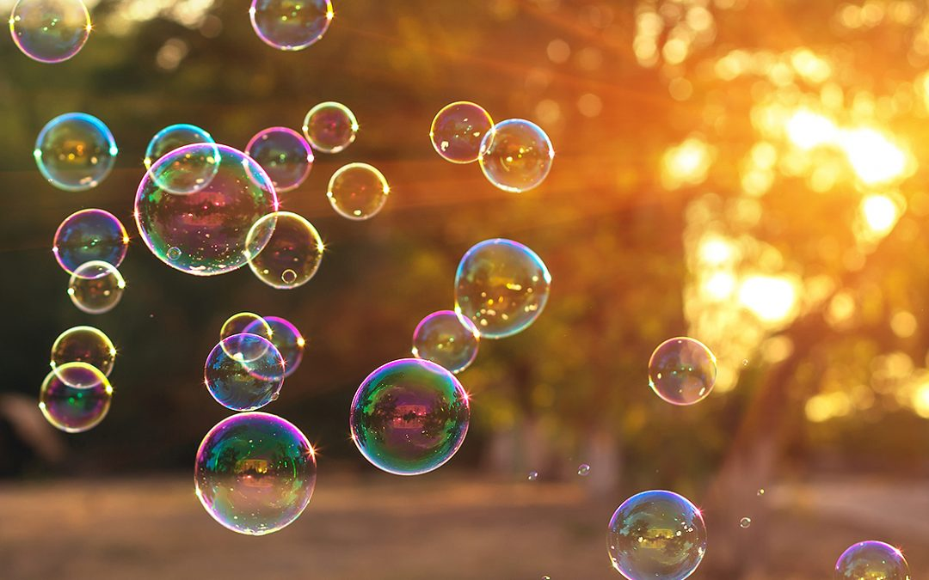
Imagine meeting someone who had never seen or blown bubbles before! Write down what you would tell them about bubbles, what they look like, how they move in the air, what happens if you touch them, how to blow bubbles, and so on.
Week 2: Thursday
Maybe later you could go outside and blow some bubbles!

Slide 12
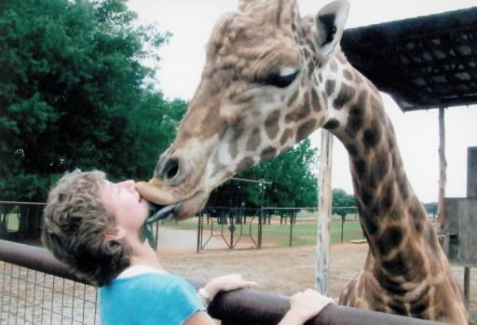
Week 2: Friday
Sick Sentences
The giraffe was in the zoo. It gave the boy a kiss.
Rewrite these sick sentences adding adjectives (describing words) , verbs (doing words) and adverbs (words that describe the verb). Make your sentences fabulous!

