Slide 1
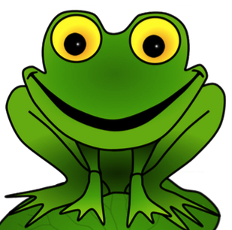
Maths

Slide 2
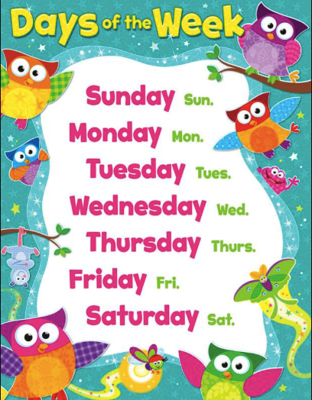

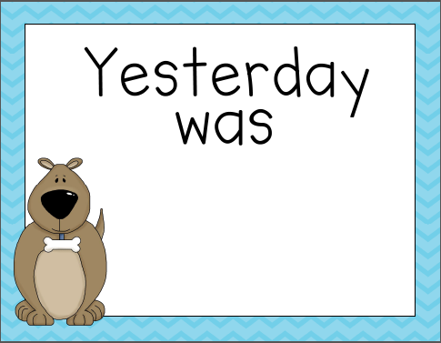


Slide 3
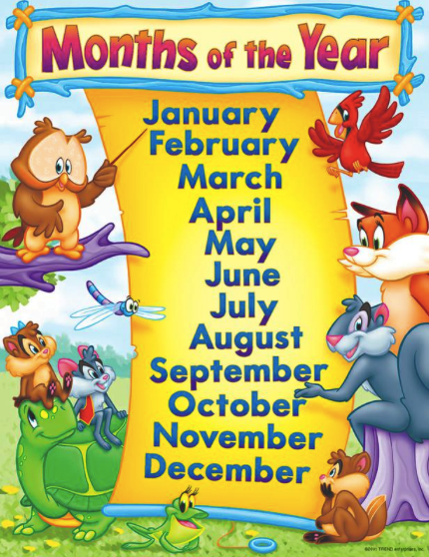
This month is:
Last month was:
Next month will be:

Slide 4

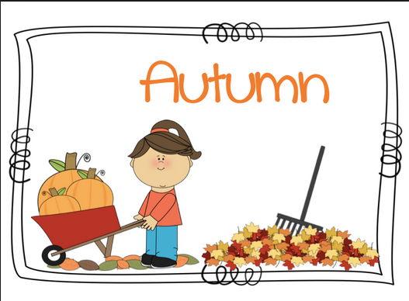


December
January
February
March
April
May
We are in _______
We were in _______
Next season is _____
June
July
August
September
October
November

Slide 5
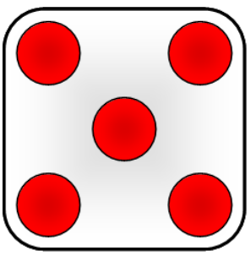
Skip counting
Sometimes you don’t have to count all the numbers.
You can count in 2s, 5s, 10s and even 3s!
How many are there altogether? Did you use skip counting?

Slide 6
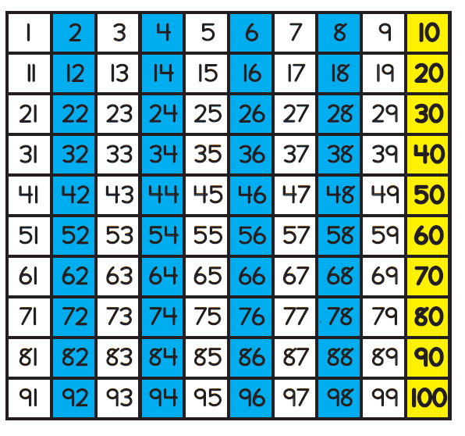
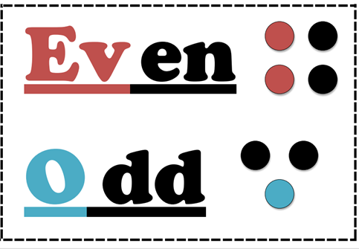
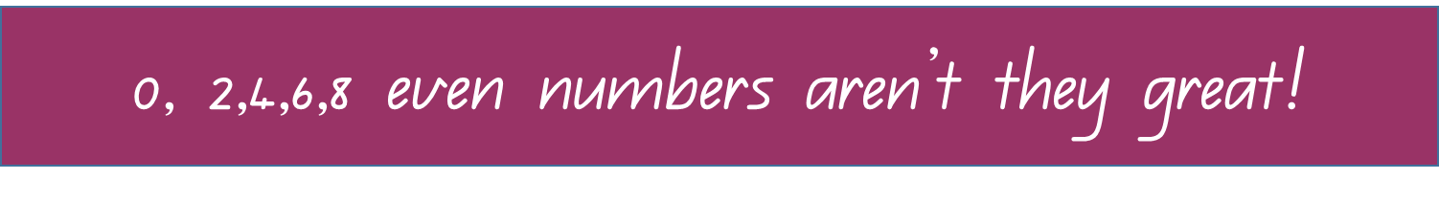
Counting forwards, backwards. One more, one less. Number recognition. Count by 2’s to 10, 10’s to 50.
Numbers from ___ to ___

Slide 7
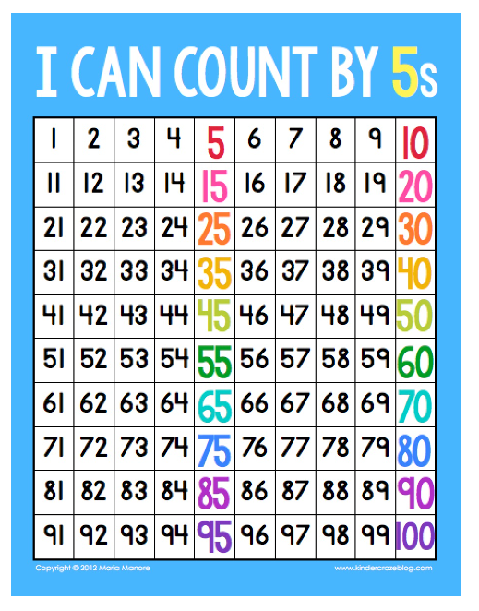
Counting forwards, backwards in 5s, 10s
Numbers from ___ to ___

Slide 8
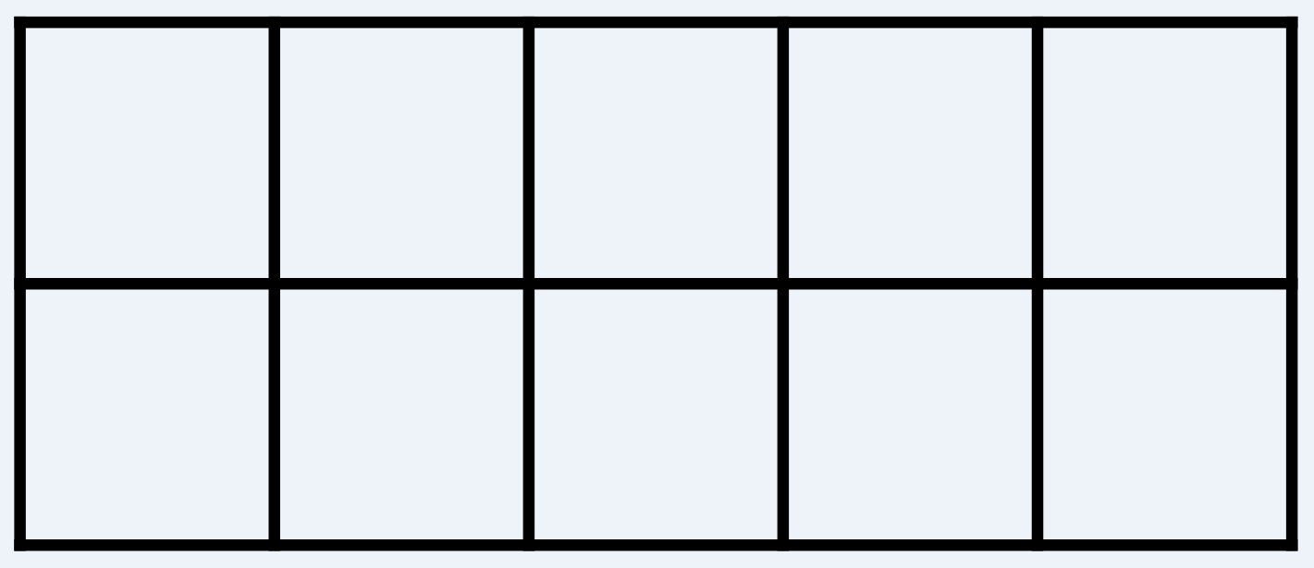
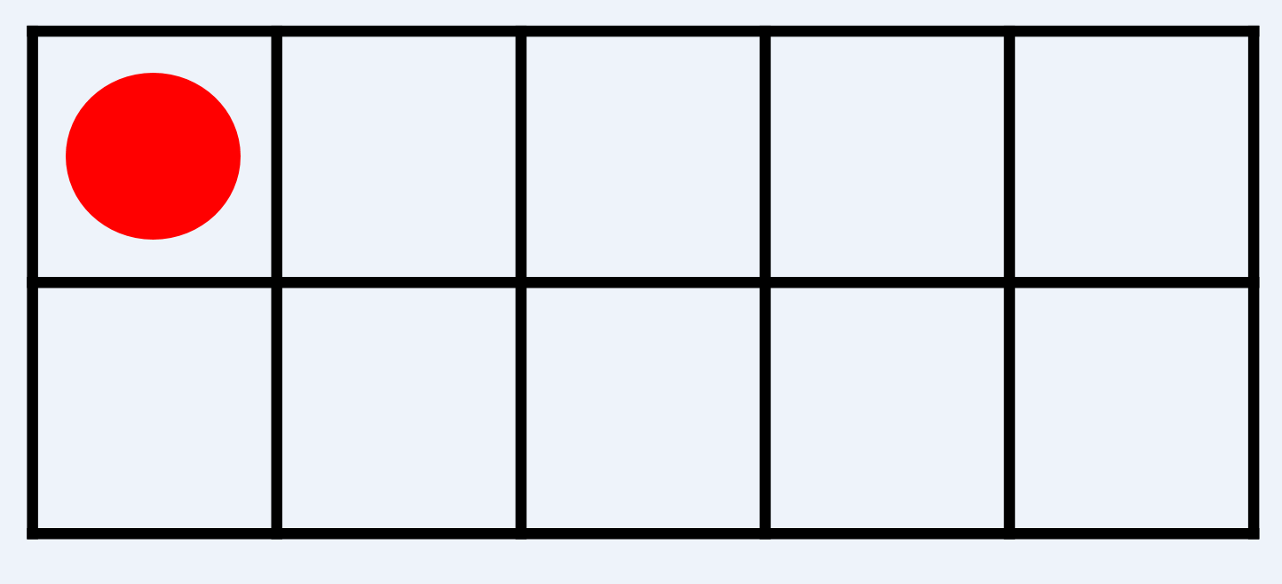
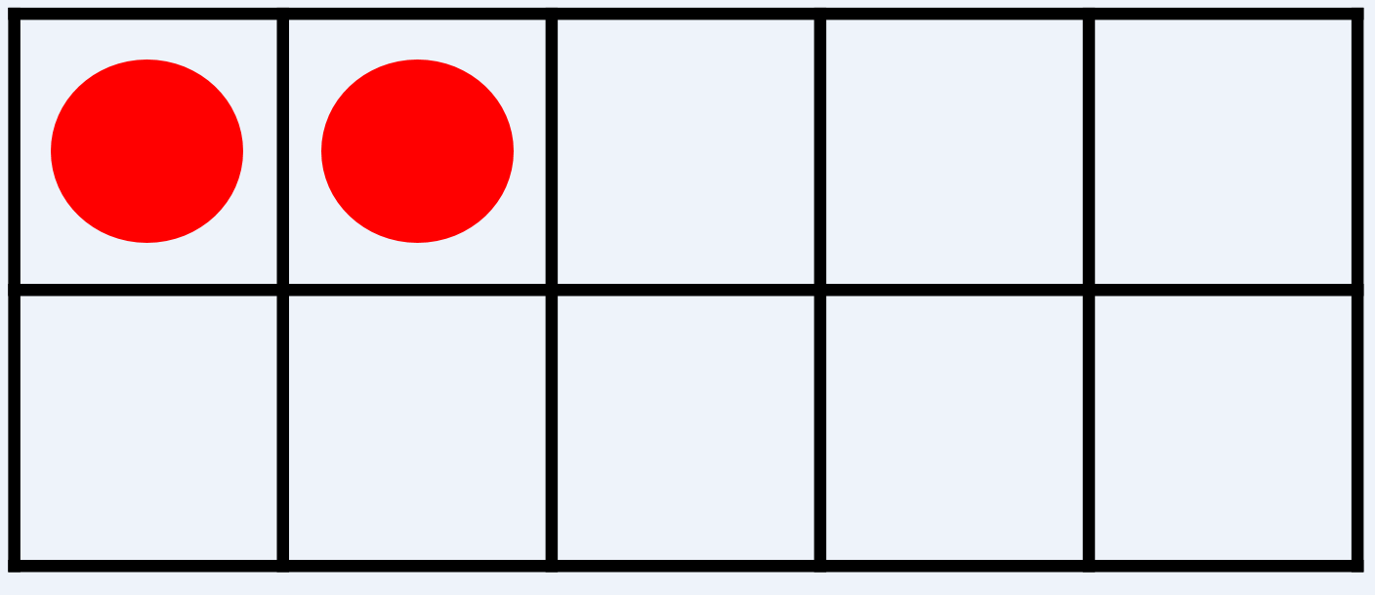
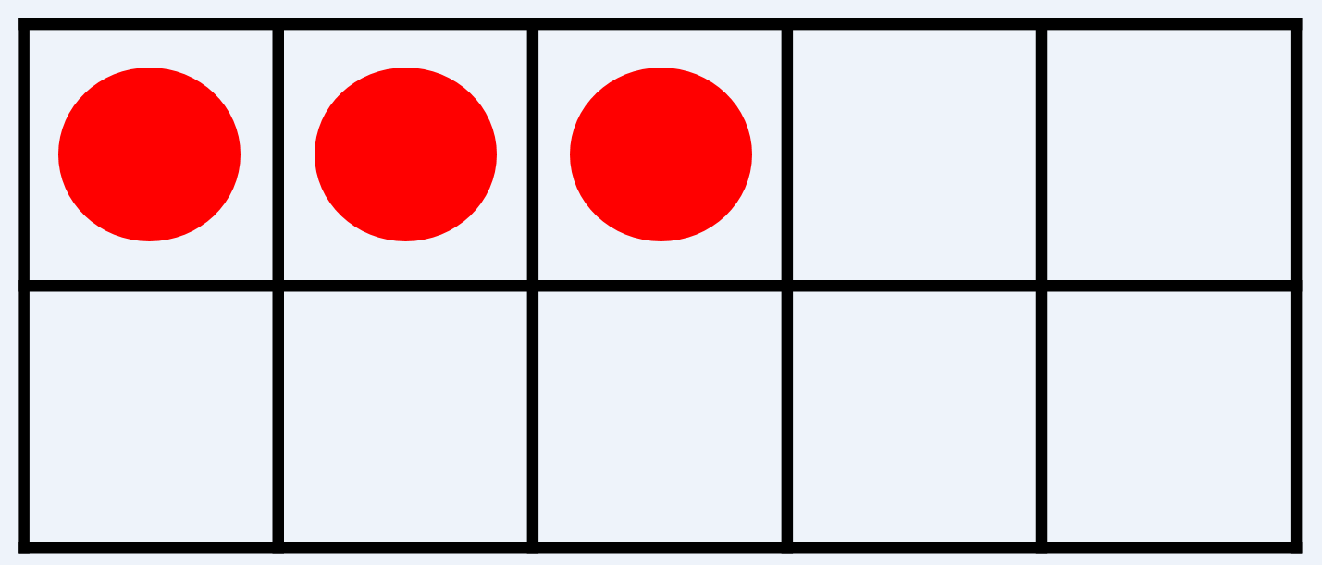
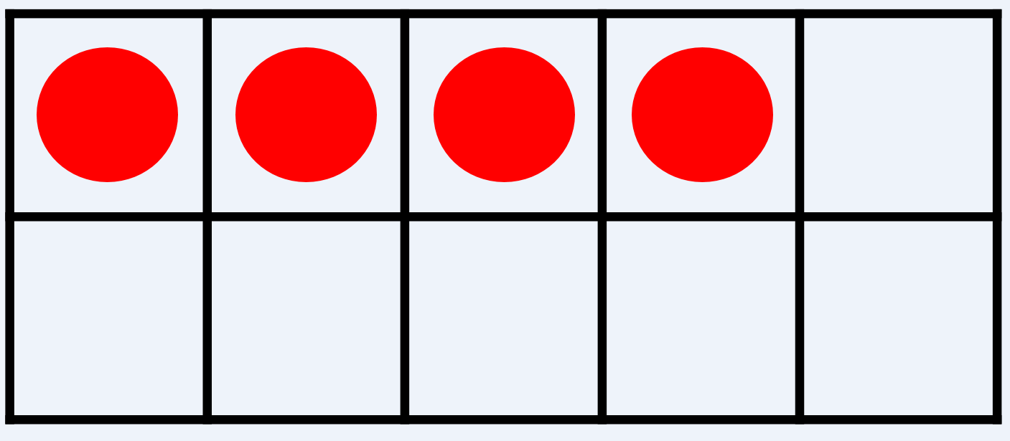
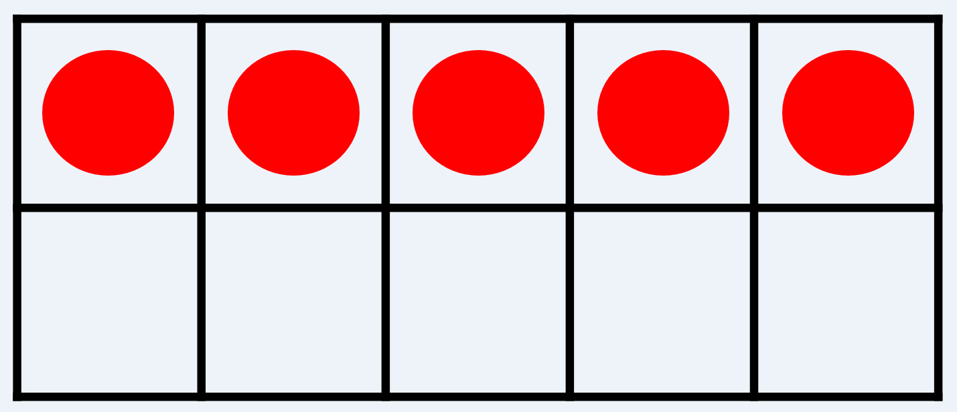
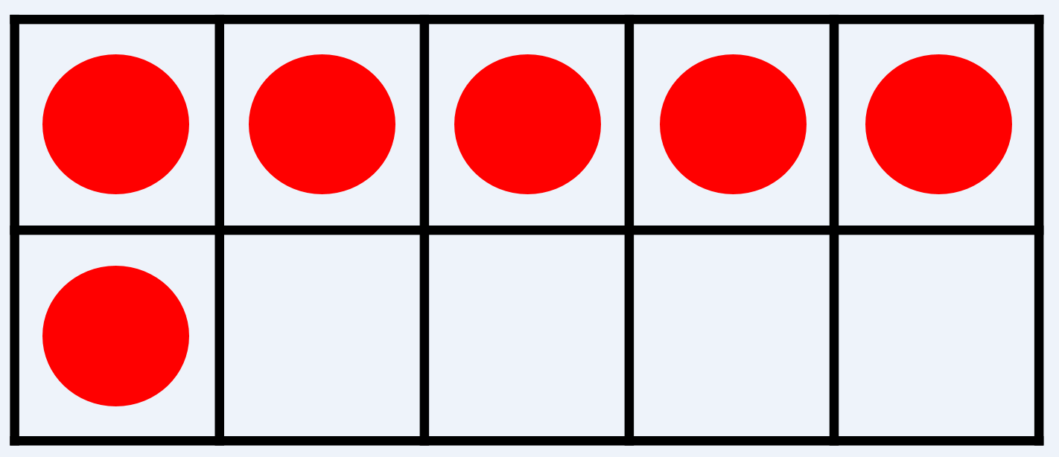
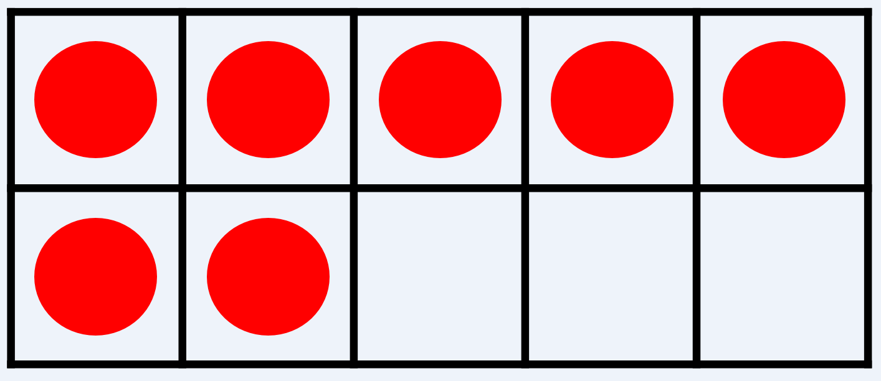
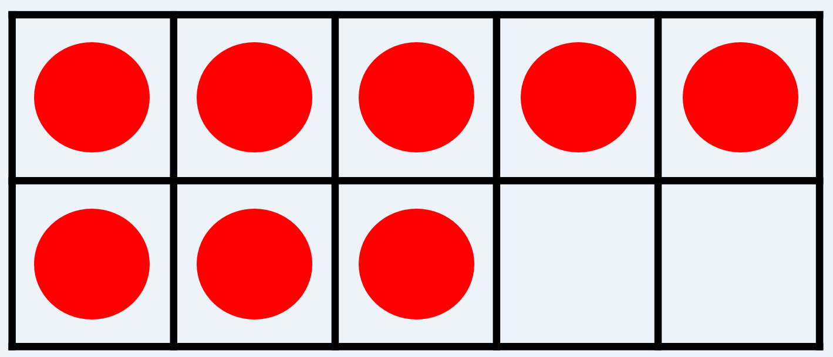
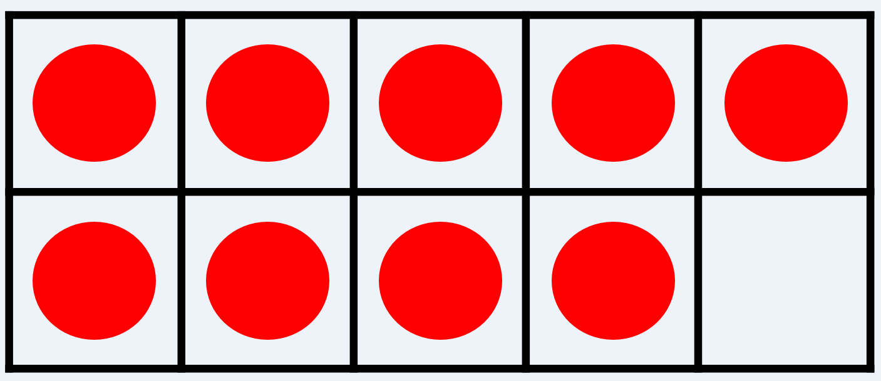
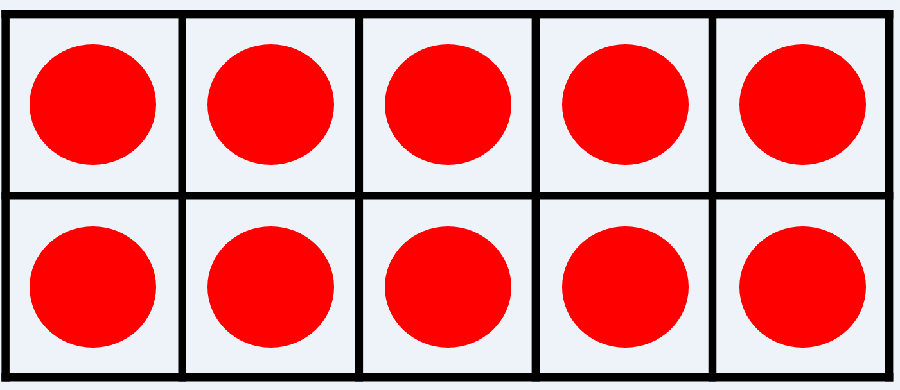
zero | 0
one | 1 | l
two | 2 | ll
three | 3 | lll
four | 4 | llll
five | 5 | llll
six | 6 | llll l
seven | 7 | llll ll
eight | 8 | llll lll
nine | 9 | llll llll
ten | 10 | llll llll

Slide 9
What number is this?

Slide 10
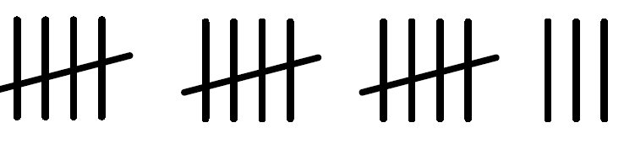

Slide 11
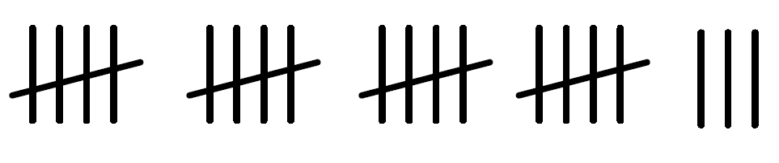

Slide 12


Slide 13


Slide 14
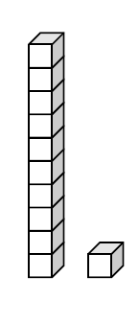

Slide 15
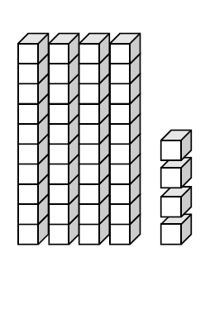

Slide 16
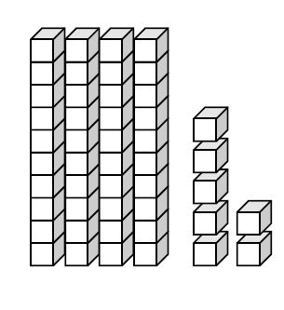

Slide 17


llllllllll
lll
llllllllll

Slide 18
llllllllll
llllllllll
llllllllll
llllllllll
llllllllll
llllllllll

Slide 19
llllllllll
llllllllll
llllllllll
llllllllll
llllllllll
llllllllll
llllllllll
llllllllll
llllllllll
llllllllll

Slide 20

1
71

Slide 21
1
27

Slide 22
1
92

Slide 23
1
81

Slide 24
200

Slide 25
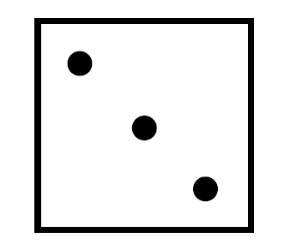

Slide 26


Slide 27


Slide 28


Slide 29


Slide 30
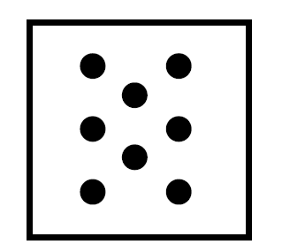

Slide 31
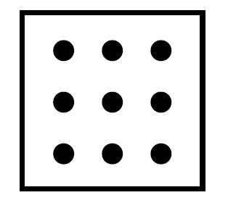

Slide 32
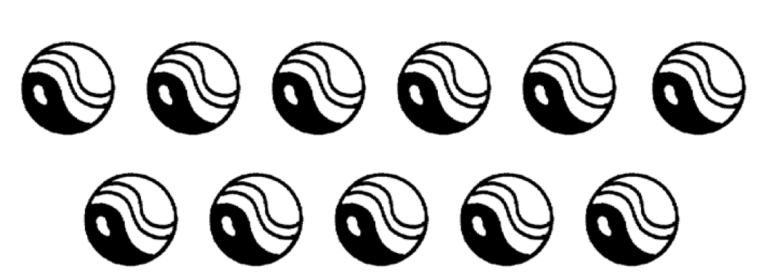

Slide 33


Slide 34
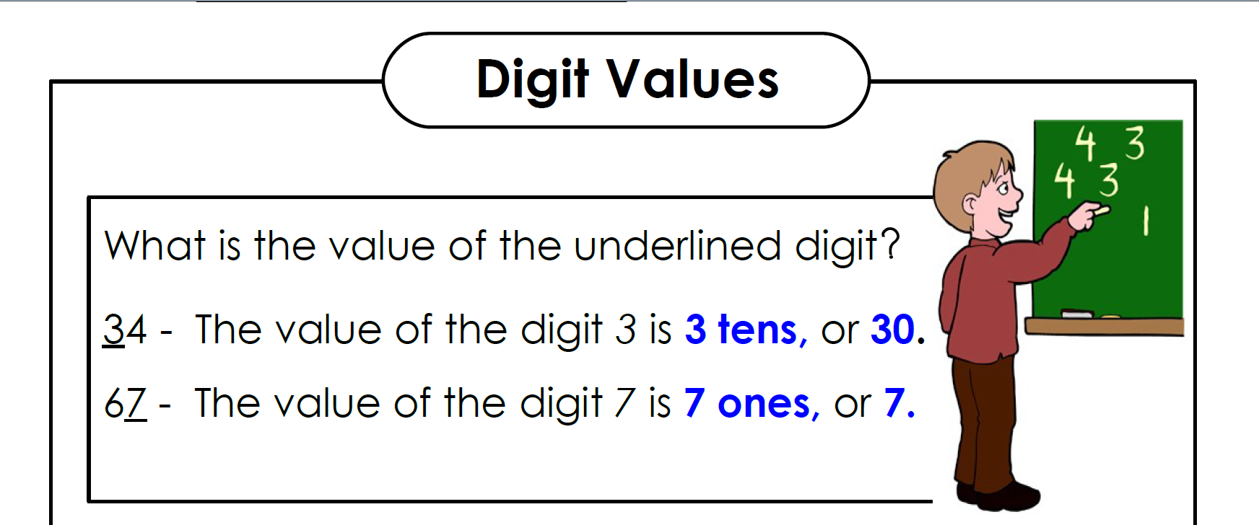

Slide 35
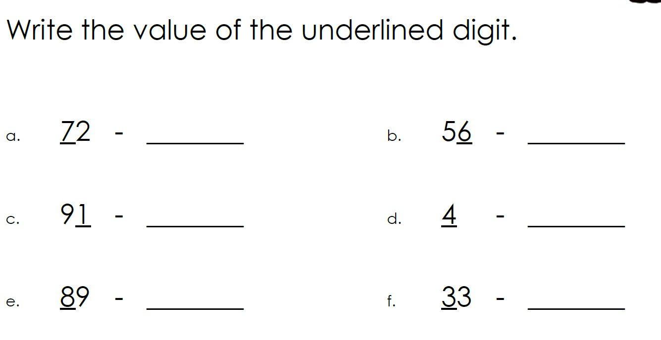

Slide 36
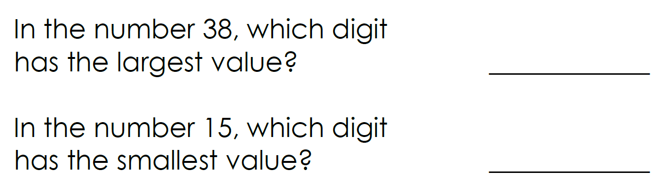

Slide 37
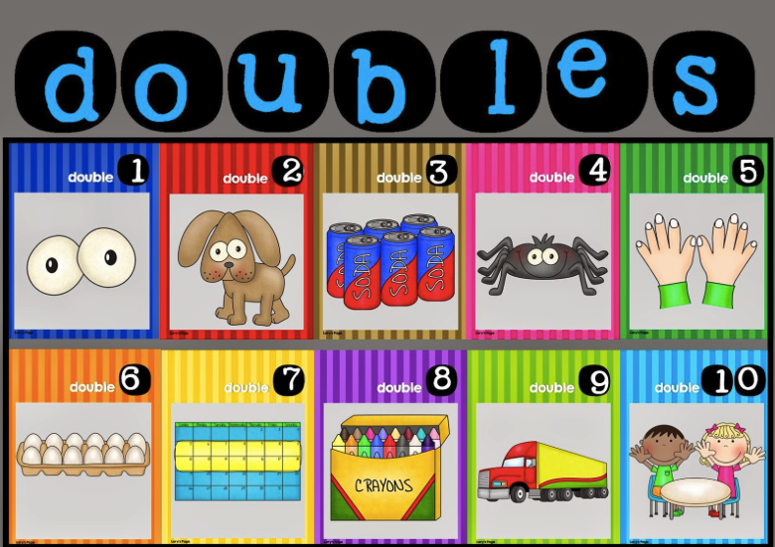
1 + 1 = 2
2 + 2 = 4
3 + 3 = 6
4 + 4 = 8
5 + 5 = 10
6 + 6 = 12
7 + 7 = 14
8 + 8 = 16
9 + 9 = 18
10 + 10 = 20

Slide 38

Halve
If you know your doubles, it is easy to halve.
Double 4 = 8
So half of 8 is 4
If

Slide 39
Half of 20

Slide 40
Half of 20 is 10 because
double 10 is 20

Slide 41
Half of 6

Slide 42
Half of 6 is 3 because
double 3 is 6

Slide 43
Half of 18

Slide 44
Half of 18 is 9 because
double 9 is 18

Slide 45
Half of 10

Slide 46
Half of 10 is 5 because
double 5 is 10

Slide 47

0 + 10 = 10
10 + 0 = 10
1 + 9 = 10
9 + 1 = 10
2 + 8 = 10
8 + 2 = 10
3 + 7 = 10
7 + 3 = 10
4 + 6 = 10
6 + 4 = 10
5 + 5 = 10
Rainbow Facts are turnarounds.
All these facts equal 10

