Slide 1

Reading Hierarchy
Year 1
Term 2

Slide 2
Graph
1 letter making 1 sound
Say the sound of each letter. Remember we don’t say ‘tuh’ for /t/ or ‘puh’ for /p/. Try to say the sounds as quickly as you can.

Slide 3
h

Slide 4
e

Slide 5
b

Slide 6
f

Slide 7
k

Slide 8
q

Slide 9
d

Slide 10
s

Slide 11
z

Slide 12
o

Slide 13
a

Slide 14
m

Slide 15
c

Slide 16
w

Slide 17
p

Slide 18
t

Slide 19
v

Slide 20
y

Slide 21
x

Slide 22
r

Slide 23
j

Slide 24
l

Slide 25
g

Slide 26
i

Slide 27
u

Slide 28
n

Slide 29
Digraph
2 letters making 1 sound
Say the sound of each digraph. Try to say the sounds as quickly as you can.

Slide 30

ay
pay

Slide 31
ow
cow

Slide 32

al
hospital

Slide 33

ar
car

Slide 34

er
flower

Slide 35

ew
screw

Slide 36

ir
bird

Slide 37

aw
claw

Slide 38

ur
nurse

Slide 39

ck
duck

Slide 40

ey
monkey

Slide 41

or
fork

Slide 42

oy
boy

Slide 43
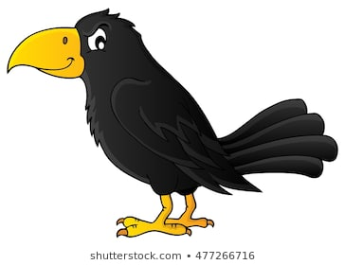
ow
crow

Slide 44

sh
shark

Slide 45

gn
sign
This is a sign

Slide 46

th
teeth

Slide 47

ch
teacher

Slide 48

ph
phone

Slide 49
th
the
them
they
this

Slide 50
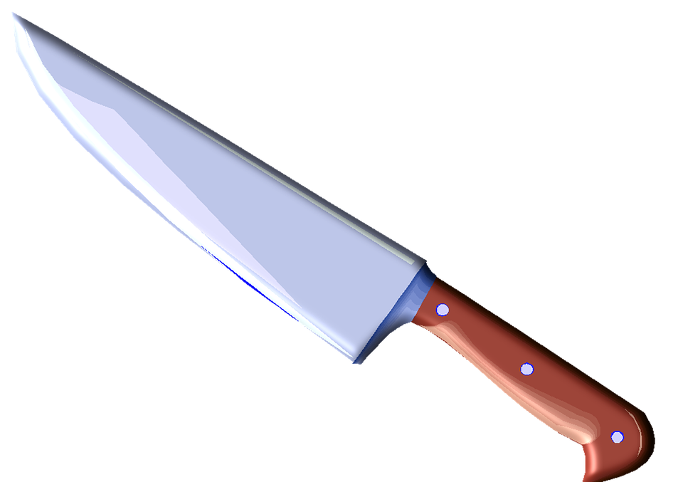
kn
knife

Slide 51

wh
whistle

Slide 52
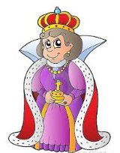
qu
queen

Slide 53
Vowels with Digraphs
Blend the vowel sound with the digraph. Try to say the sounds as quickly as you can.

Slide 54

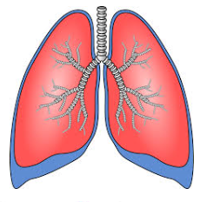
ng
ong
ang
ing
eng
ung

Slide 55





ck
ock
ack
ick
eck
uck

Slide 56



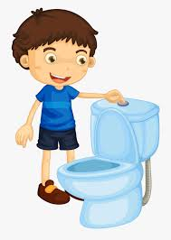

sh
osh
ash
ish
esh
ush

Slide 57
Split Digraph
2 letters making 1 sound
Uses bossy e
Bossy e makes the vowel sound say its own name. Try to say the sounds as quickly as you can.

Slide 58

a_e
whale

Slide 59

i_e
mice

Slide 60

u_e
cute

Slide 61

o_e
cone

Slide 62
Trigraph
3 letters making 1 sound
Say the sound of each trigraph. Try to say the sounds as quickly as you can.

Slide 63
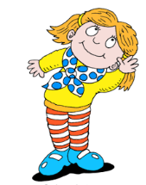
hear
ear

Slide 64
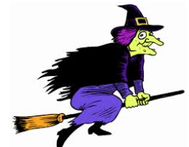
tch
witch

Slide 65
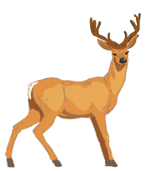
eer
deer

Slide 66

air
chair

Slide 67

igh
night

Slide 68

are
square

Slide 69

dge
bridge

Slide 70
Quadgraph
4 letters making 1 sound
Say the sound of each quadgraph. Some quadgraphs can make more than one sound. Try to say the sounds as quickly as you can.

Slide 71
ough
/o/ – dough
/00/ - through
/ow/ drought
/uff/ – rough
/off/ - cough
/aw/ thought
Say the sound of each quadgraph then the word e.g. “ough says /o/ as in dough, /00/ as in through, /ow/ as in drought, /uff/ as in rough, /off/ as in cough and /aw/ as in thought.

Slide 72
aigh
straight

Slide 73
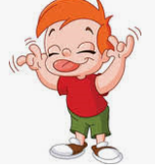
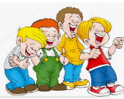
augh
/aw/ – naughty /aff/ - laugh

Slide 74


eigh
/a/ – eight /i/ - height

Slide 75
Blend
2 or 3 letters that blend together smoothly

Slide 76

pr
practice

Slide 77

tw
twenty

Slide 78

tr
train

Slide 79
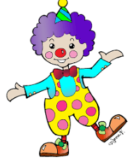
clown
cl

Slide 80

gl
glove

Slide 81

bl
blue

Slide 82

sc
scoop

Slide 83

br
bride

Slide 84

sl
sleep

Slide 85

cr
crab

Slide 86

sm
smile

Slide 87

gr
grass

Slide 88

fr
frog

Slide 89

fl
flag

Slide 90
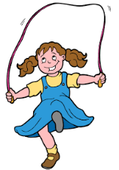
skip
sk

Slide 91

stop
st

Slide 92
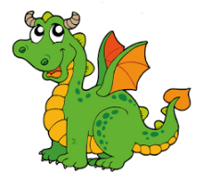
dr
dragon

Slide 93
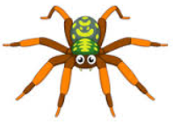
sp
spider

Slide 94

sw
sweets

Slide 95

lb
bulb

Slide 96
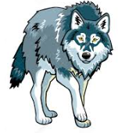
lf
wolf

Slide 97

nk
pink

Slide 98

sp
gasp

Slide 99

st
list

Slide 100
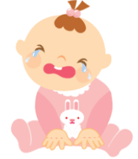
pt
wept

Slide 101

ld
gold

Slide 102

lt
belt

Slide 103
3 letter blends

Slide 104


sch
/sc/ - school /sh/ - schmuck

Slide 105
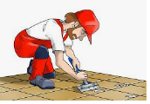
scr
scrape

Slide 106
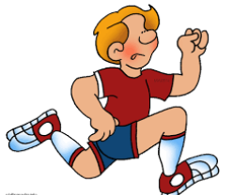
spr
sprint

Slide 107
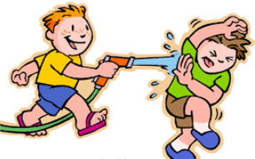
squ
squirt

Slide 108
Dipthong
2 vowels in 1 syllable
When two vowels go walking, the first one does the talking.
The first vowel says its own name, unless otherwise stated. Some dipthongs can make more than one sound e.g. ou says /u/ as in colour etc

Slide 109

ee
bee

Slide 110

oa
boat

Slide 111
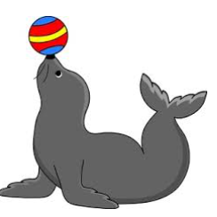
ea
seal

Slide 112
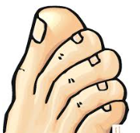
oe
toes

Slide 113

ai
paint

Slide 114

oo
baloon

Slide 115

oo
book

Slide 116
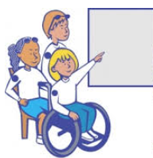
oi
point

Slide 117


ou
/ow/ - mouse
/or/ - four
/u/ - colour
/oo/ - could
/oo/ - group

Slide 118


ie
/i/ - pie
/ee/ - boogie

Slide 119
Double Consonants
2 graphemes 1 sound
Say the sound of each double consonant. Remember, even though there are 2 of the same letter, it only makes one sound. Try to say the sounds as quickly as you can.

Slide 120
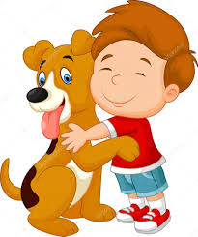
dd
cuddle

Slide 121
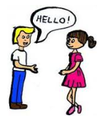
ll
hello

Slide 122

ff
coffee

Slide 123

gg
digging

Slide 124

mm
dummy

Slide 125

pp
apple

Slide 126

rr
cherry

Slide 127

nn
sunny

Slide 128

bb
bubbles

Slide 129

ss
kiss

Slide 130

tt
kitten

Slide 131
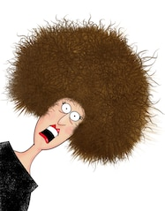
zz
frizzy

Slide 132
Blending and Tracking

Slide 133
Tracking is reading left to right from the first sound to the last sound, blending as we go.

Slide 134
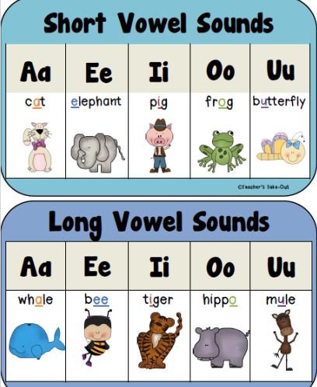
Short Vowels
a e i o u
Say “/a/ as in cat, /e/ as in elephant, /i/ as in pig, /o/ as in frog, /u/ as in butterfly”.

Slide 135
Track the letters from left to right with your eyes and say the sounds, Remember to say the short vowel sound e.g.
/b/ /a//n/
/d/ /e/ /p/
/f/ /i/ /s/
/g/ /o/ /t/
/m/ /u/ /l/
b | a | n
d | e | p
f | i | s
g | o | t
m | u | l

Slide 136
ch | a | mp
br | e | ld
gl | i | st
th | o | sh
cl | u | ck

Slide 137
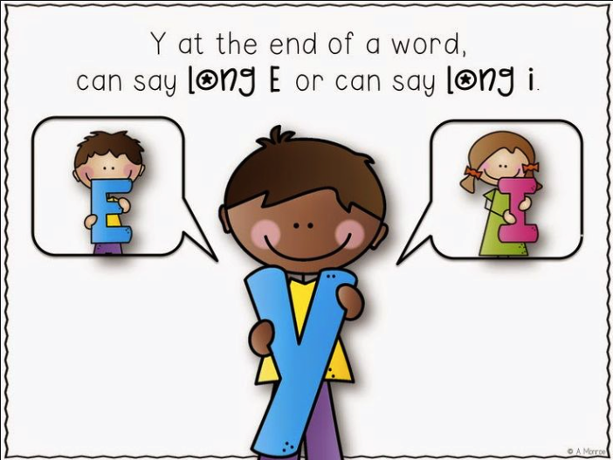
Long Vowels
a e i o u
ay
a
Say “/a/ as in whale, /e/ as in bee, /i/ as in tiger, /o/ as in hippo, /u/ as in mule”. At the end of a word, y can say /ay/, /I/ or /ee/

Slide 138
Track the letters from left to right with your eyes and say the sounds, Remember to say the short long sound e.g.
/b/ /a//n/
/d/ /e/ /p/
/f/ /i/ /s/
/g/ /o/ /t/
/m/ /u/ /l/
b | a | n
d | e | p
f | i | s
g | o | t
m | u | l

Slide 139
ch | a | mp
br | e | ld
gl | i | st
th | o | sh
cl | u | ck

Slide 140
Have a go at saying these nonsense words. Track with your eyes from left to right, saying the sounds as you go. Then try and put all the sounds together to say the word.
dingterpoms

Slide 141
bloskmingerplerp

Slide 142
Segmenting. Say each sound in the word. Then say the complete word e.g. /c/ /l/ /a/ /p/ clap
c/l/a/p
clap

Slide 143
t/r/u/ck
truck

Slide 144
s/p/ar/k/le
sparkle

Slide 145

Syllables
Stand up and get your robot arms ready. Move from side to side like a robot as you say each syllable. Then put the word together.

Slide 146
2 syllables
birth/day
birthday

Slide 147
3 syllables
to/mor/row
tomorrow

Slide 148
4 syllables
Aus/tra/li/a
Australia

Slide 149
5 syllables
per/son/al/it/y
personality

Slide 150
Say the word and count the syllables.

Slide 151
magazine

Slide 152
helicopter

Slide 153
responsibility

Slide 154
recycling

Slide 155
absolutely

Slide 156
Sight Words
Read these words as quickly as you can. If you need help, an adult can say the words for you and you can repeat them. Make sure you are looking at the word as you say it.

Slide 157
one

Slide 158
not

Slide 159
with

Slide 160
her

Slide 161
we

Slide 162
you

Slide 163
his

Slide 164
he

Slide 165
they

Slide 166
so

Slide 167
on

Slide 168
if

Slide 169
up

Slide 170
by

Slide 171
my

Slide 172
do

Slide 173
go

Slide 174
no

Slide 175
an

Slide 176
big

Slide 177
has

Slide 178
can

Slide 179
out

Slide 180
new

Slide 181
who

Slide 182
see

Slide 183
old

Slide 184
off

Slide 185
now

Slide 186
have

Slide 187
two

Slide 188
get

Slide 189
she

Slide 190
well

Slide 191
made

Slide 192
into

Slide 193
went

Slide 194
from

Slide 195
this

Slide 196
back

Slide 197
like

Slide 198
just

Slide 199
them

Slide 200
over

Slide 201
came

Slide 202
been

Slide 203
down

Slide 204
much

Slide 205
want

Slide 206
first

Slide 207
there

Slide 208
look

Slide 209
could

Slide 210
which

Slide 211
where

Slide 212
make

Slide 213
little

Slide 214
about

Slide 215
other

Slide 216
right

Slide 217
their

Slide 218
your

Slide 219
here

Slide 220
some

Slide 221
were

Slide 222
only

Slide 223
come

Slide 224
will

Slide 225
must

Slide 226
call

Slide 227
then

Slide 228
make

Slide 229
us

Slide 230
sing

Slide 231
girl

Slide 232
five

Slide 233
am

Slide 234
play

Slide 235
help

Slide 236
fly

Slide 237
read

Slide 238
eat

Slide 239
jump

Slide 240
day

Slide 241
home

Slide 242
ran

Slide 243
saw

Slide 244
sit

Slide 245
good

Slide 246
boy

Slide 247
after

Slide 248
think

Slide 249
how

Slide 250
own

Slide 251
give

Slide 252
mother

Slide 253
left

Slide 254
walk

Slide 255
best

Slide 256
too

Slide 257
bring

Slide 258
step

Slide 259
wish

Slide 260
find

Slide 261
again

Slide 262
these

Slide 263
say

Slide 264
room

Slide 265
far

Slide 266
kind

Slide 267
ask

Slide 268
man

Slide 269
water

Slide 270
bird

Slide 271
let

Slide 272
hand

Slide 273
keep

Slide 274
fast

Slide 275
thing

Slide 276
going

Slide 277
school

Slide 278
work

Slide 279
night

Slide 280
round

Slide 281
dog

Slide 282
always

Slide 283
many

Slide 284
tree

Slide 285
four

Slide 286
away

Slide 287
people

Slide 288
take

Slide 289
head

Slide 290
found

Slide 291
should

Slide 292
would

Slide 293
white

Slide 294
under

Slide 295
once

Slide 296
black

Slide 297
three

Slide 298
got

Slide 299
know

Slide 300
may

Slide 301
another

Slide 302
live

Slide 303
tell

Slide 304
bad

Slide 305
run

Slide 306
put

Slide 307
don’t

Slide 308
father

Slide 309
last

Slide 310
green

Slide 311
time

Slide 312
soon

Slide 313
than

Slide 314
every

Slide 315
any

Slide 316
blue

Slide 317
red

Slide 318
fell

Slide 319
very

Slide 320
house

Slide 321
open

Slide 322
sat

Slide 323
year

Slide 324
gave

Slide 325
because

Slide 326
morning

Slide 327
long

Slide 328
why

Slide 329
You are
FABULOUS

