Slide 1
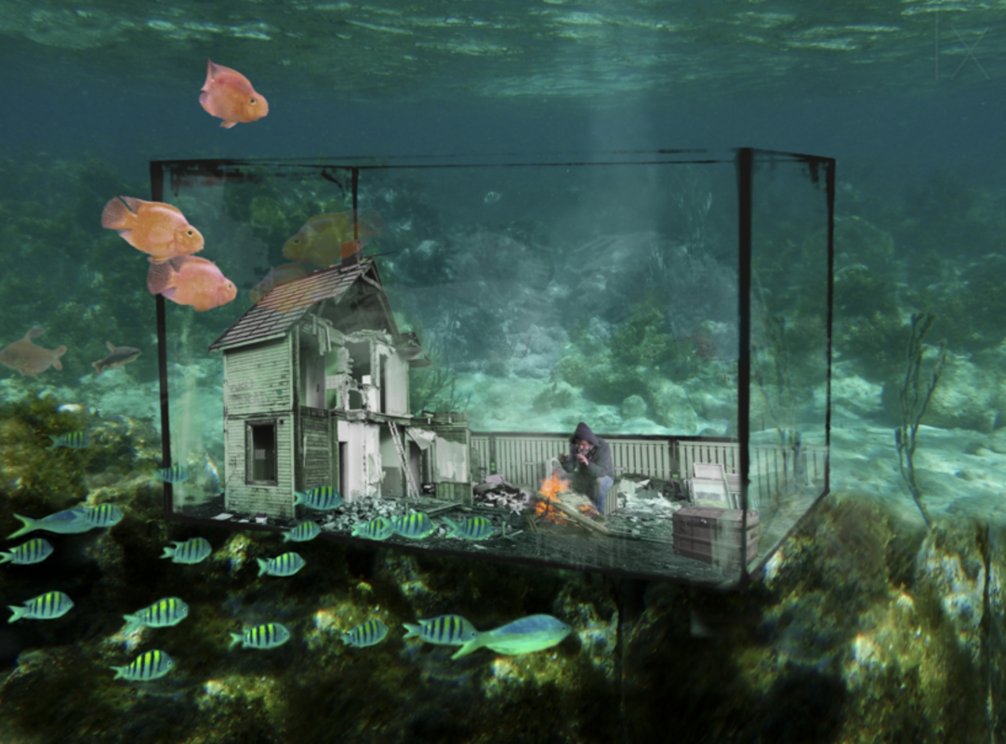

Slide 2
Monday
Watery World
Sean was the only person who had taken notice of the warning. A great flood had swept over the planet, and now life was very different...
Sentence challenge!
Brackets can be used to add some extra information to a sentence. Add some information in brackets to these sentences.
Sean’s home ( ) was quite comfortable.
The sea ( ) was filled with colourful fish.
His house ( ) was quite rickety.

Slide 3
Tuesday
Watery World
Sean was the only person who had taken notice of the warning. A great flood had swept over the planet, and now life was very different...
Question time!
How did Sean survive the great flood?
Can you make a list of all of the things Sean needs to survive? How will he obtain them all?
What are the biggest dilemmas that Sean faces? How will he overcome them?
Is he alone?

Slide 4
Watery World
Sean was the only person who had taken notice of the warning. A great flood had swept over the planet, and now life was very different...
Sick sentences!
These sentences are ‘sick’ and need your help to get better. Can you help?
Sean lived underwater. Lots of fish swam around him. The water was blue. The water was clear. He was alone.
Thursday

Slide 5
Friday
Watery World
Sean was the only person who had taken notice of the warning. A great flood had swept over the planet, and now life was very different...
Perfect picture!
Can you design the perfect underwater home?

